Slide 1


Sacredness of
Vows and Pledges
Notes:
Presented:
SSD Zoom Meeting (2020)

Slide 2

SACREDNESS OF
VOWS AND PLEDGES
(Based on “Counsels on Stewardship, chapters 59-61)

Slide 3
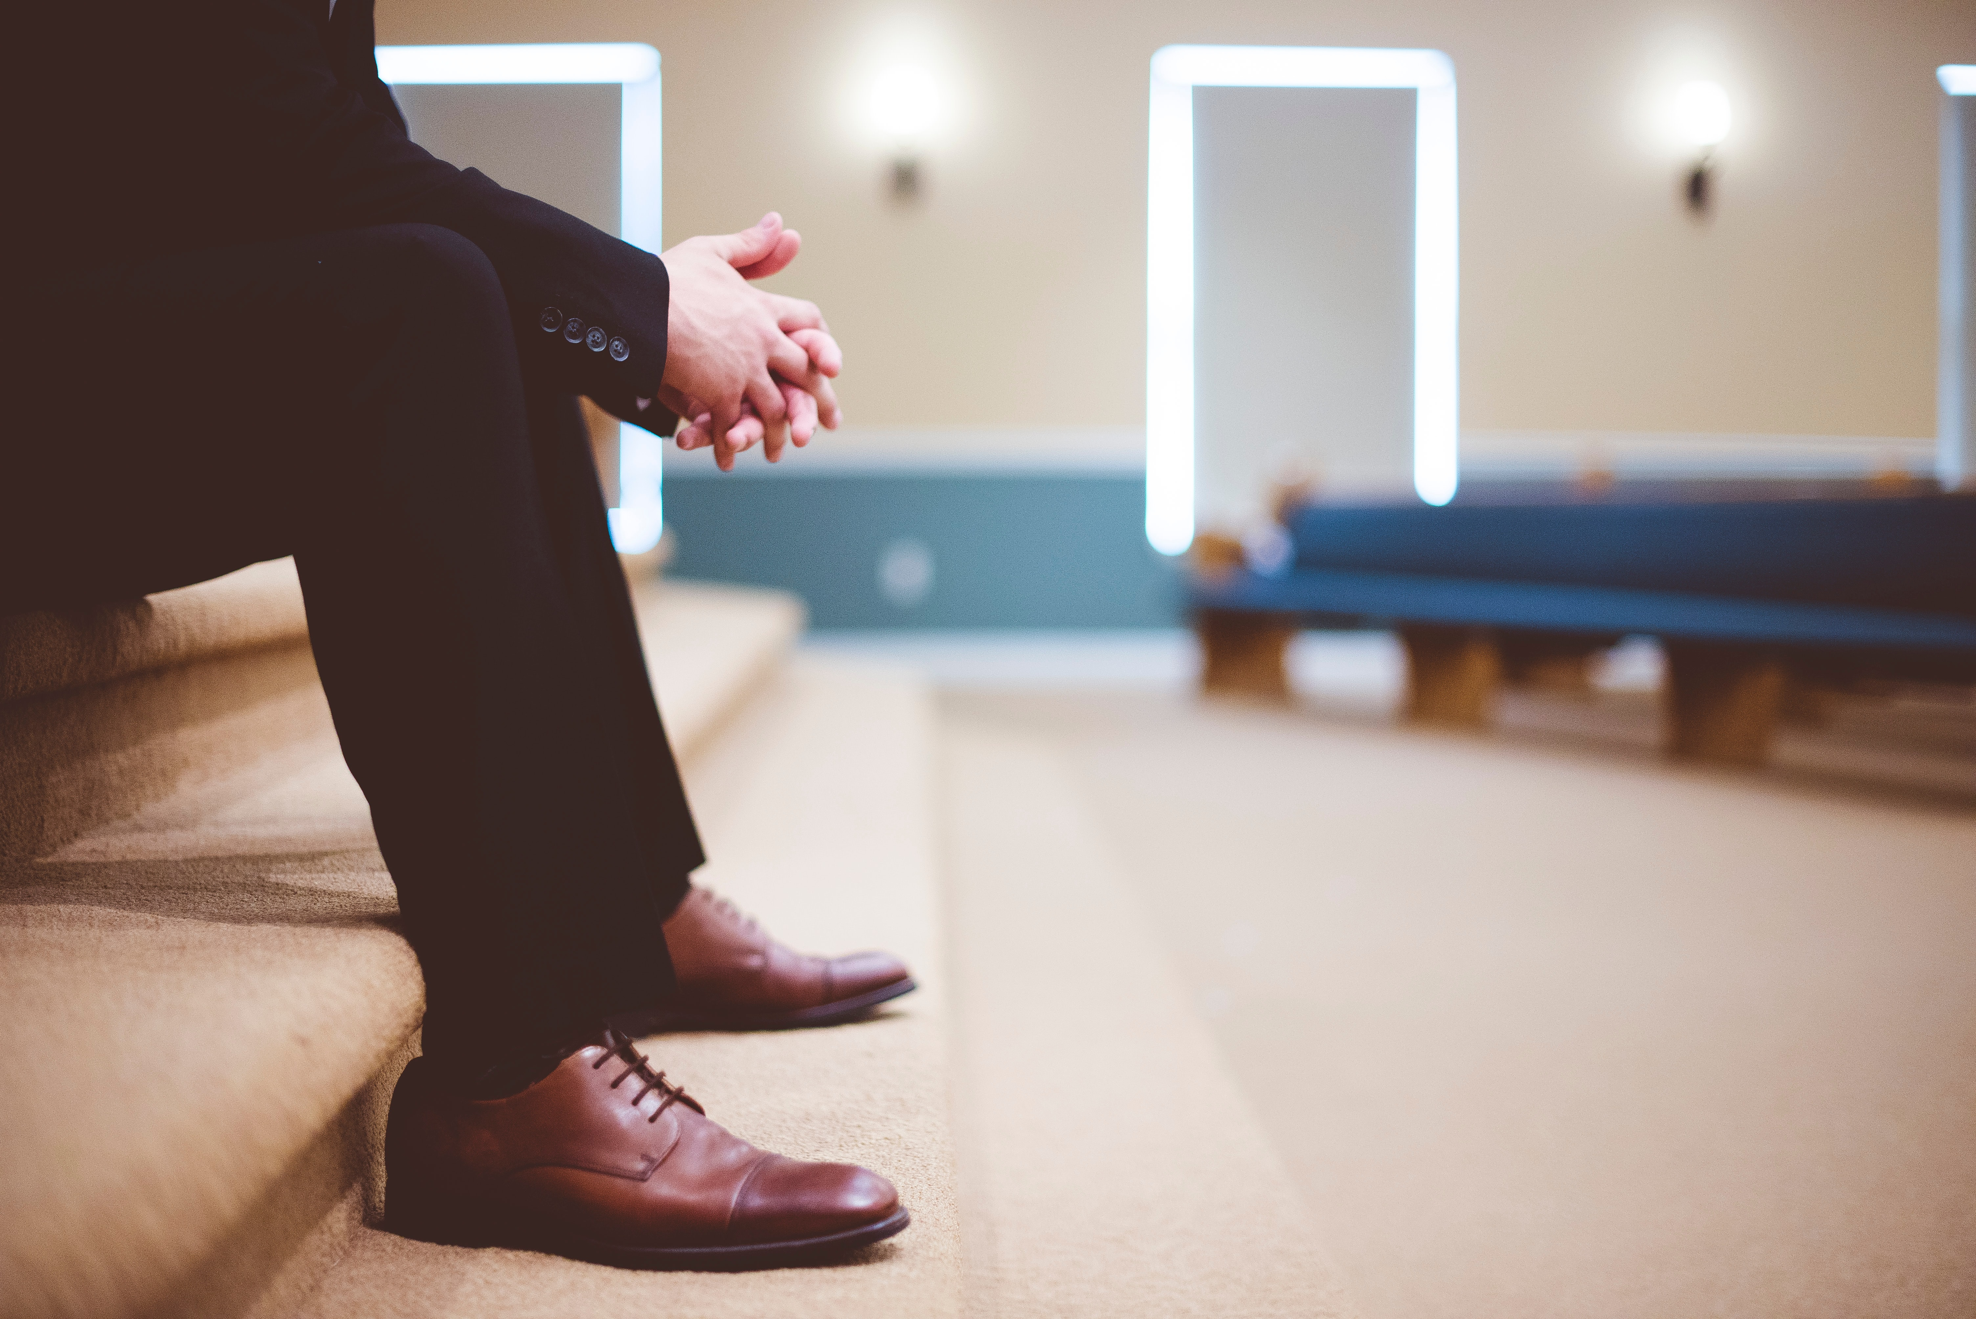
Law Concerning Vows (Num. 30:1, 2)
“Then Moses spoke to the heads of the tribes concerning the children of Israel, saying, ‘This is the thing which the Lord has commanded: If a man makes a vow to the Lord,

Slide 4
Law Concerning Vows (Num. 30:1, 2)
or swears an oath to bind himself by some agreement, he shall not break his word; he shall do according to all that proceeds out of his mouth.”

Slide 5
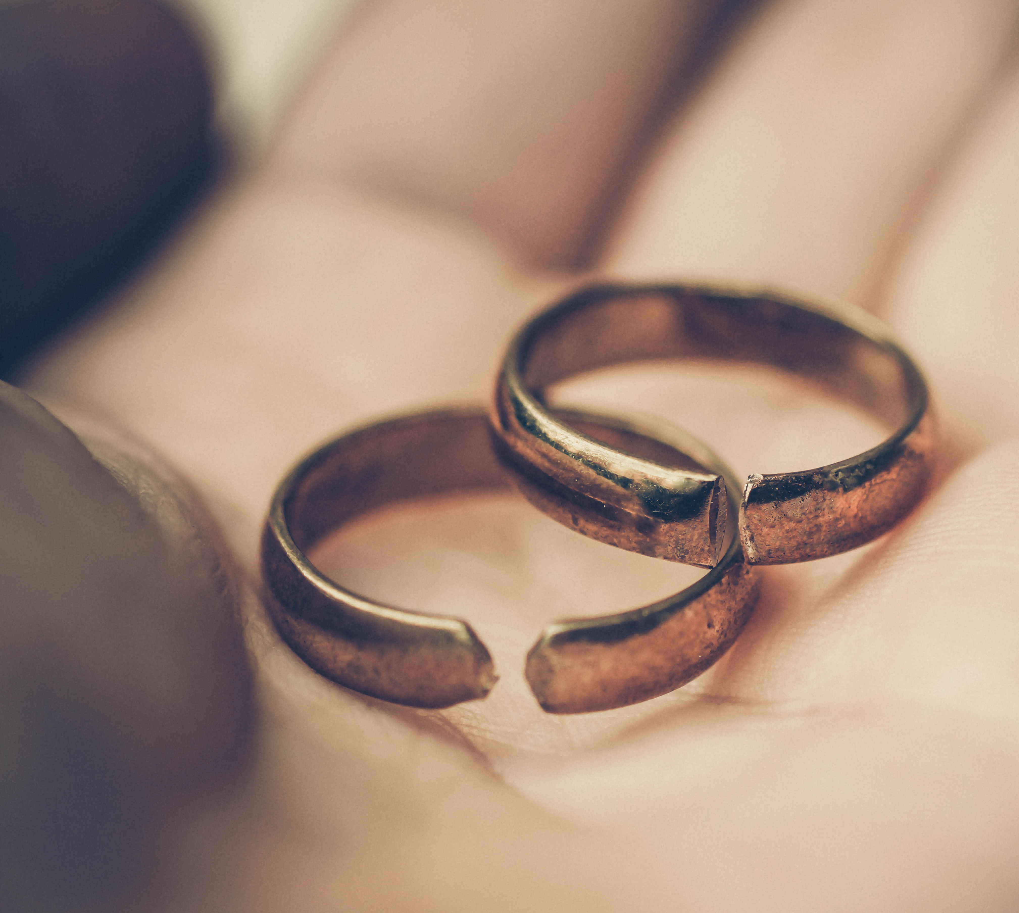
Consequence of Breaking Vows
“Do not let your mouth cause your flesh to sin, nor say before the messenger of God that it was an error. Why should God be angry at your [a]excuse and destroy the work of your hands?” Eccl. 5:6

Slide 6
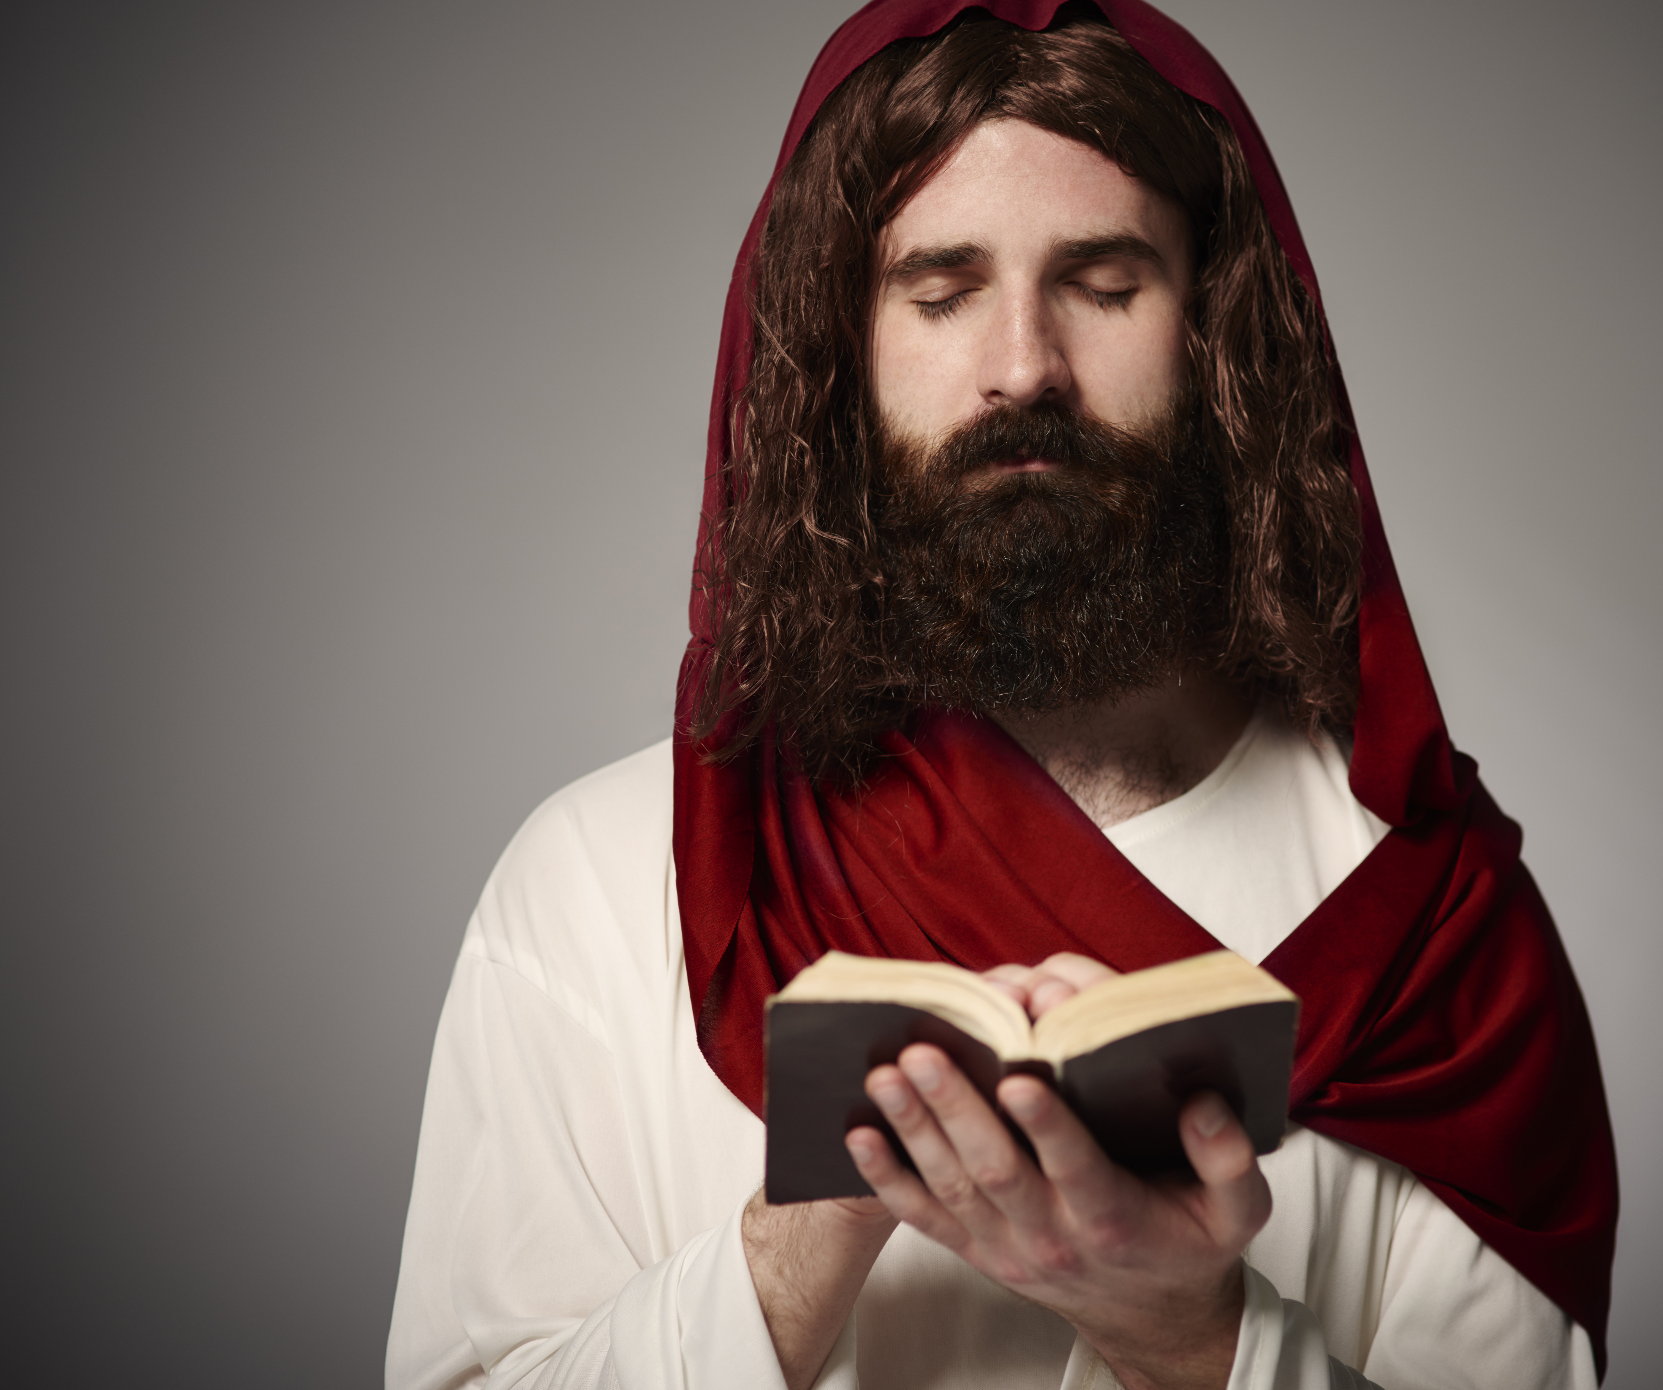
A Place to Pay my Vows
“I will go into Your house with burnt offerings; I will pay You my vows, Which my lips have uttered And my mouth has spoken when I was in trouble.”
Psalm 66:13-14

Slide 7
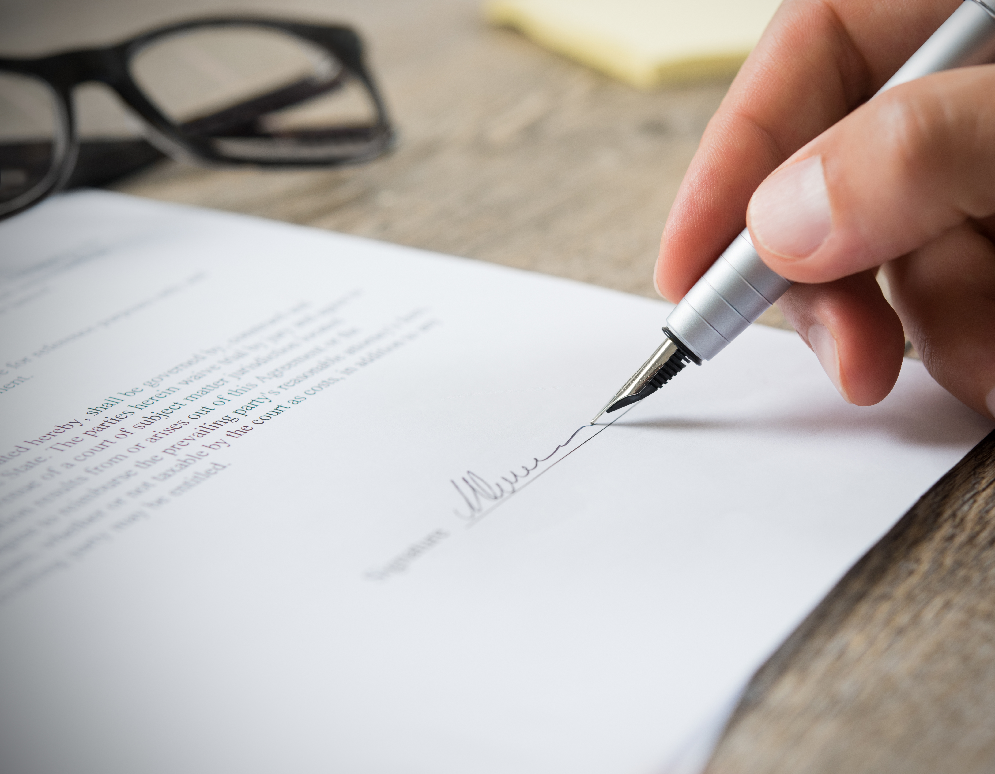
Beware of a Snare
“It is a snare for a man to devote rashly something as holy, And afterward to reconsider his vows.”
Prov. 20:25

Slide 8
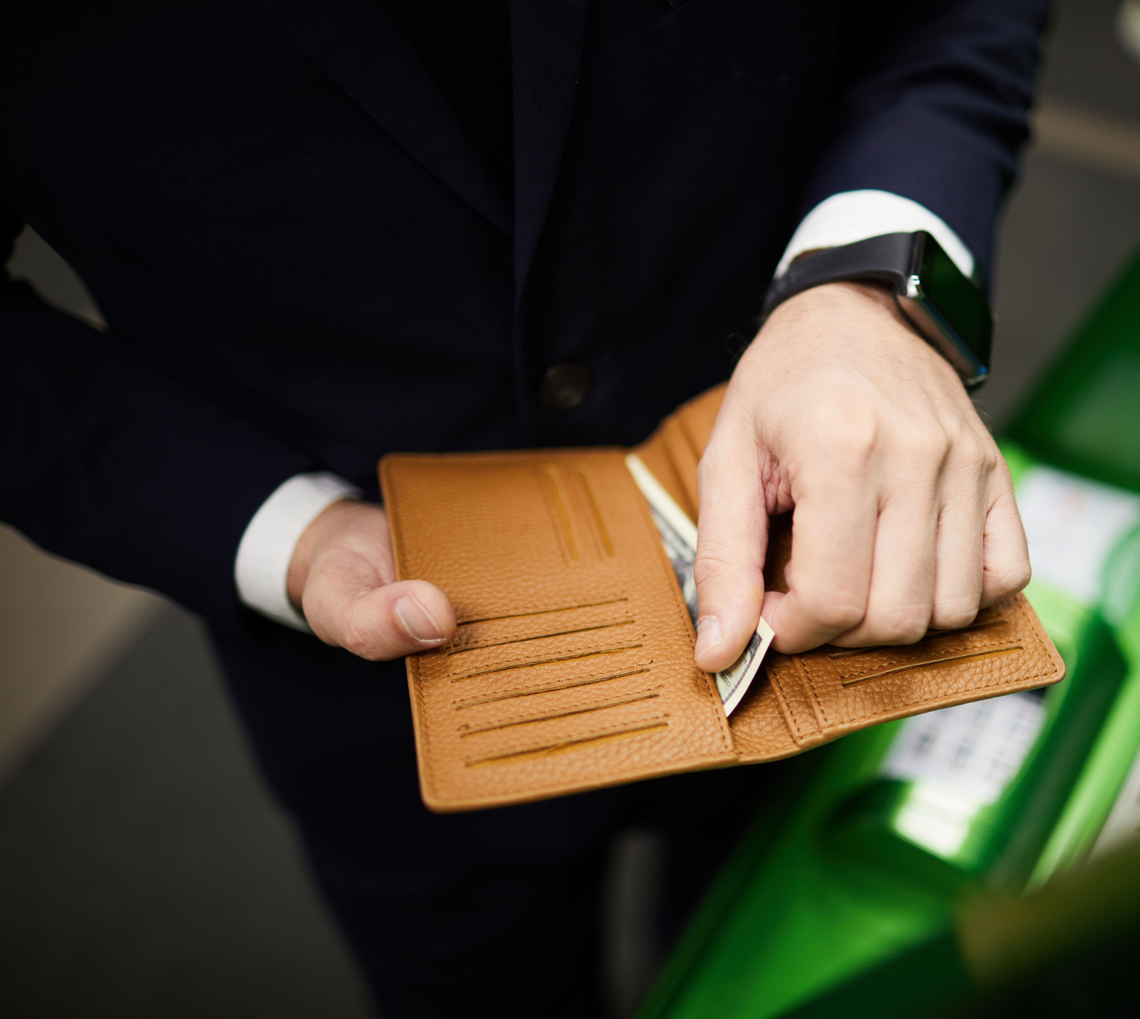
Do Not Delay to Pay It
“When you make a vow to God, do not delay to pay it; For He has no pleasure in fools. Pay what you have vowed— Better not to vow than to vow and not pay.”
Eccl. 5:4, 5.

Slide 9

God First (Deut. 23:21-23)
“When you make a vow to the Lord your God, you shall not delay to pay it; for the Lord your God will surely require it of you, and it would be sin to you.

Slide 10
God First (Deut. 23:21-23)
But if you abstain from vowing, it shall not be sin to you. That which has gone from your lips you shall keep and perform, for you voluntarily vowed to the Lord your God what you have promised with your mouth.”

Slide 11
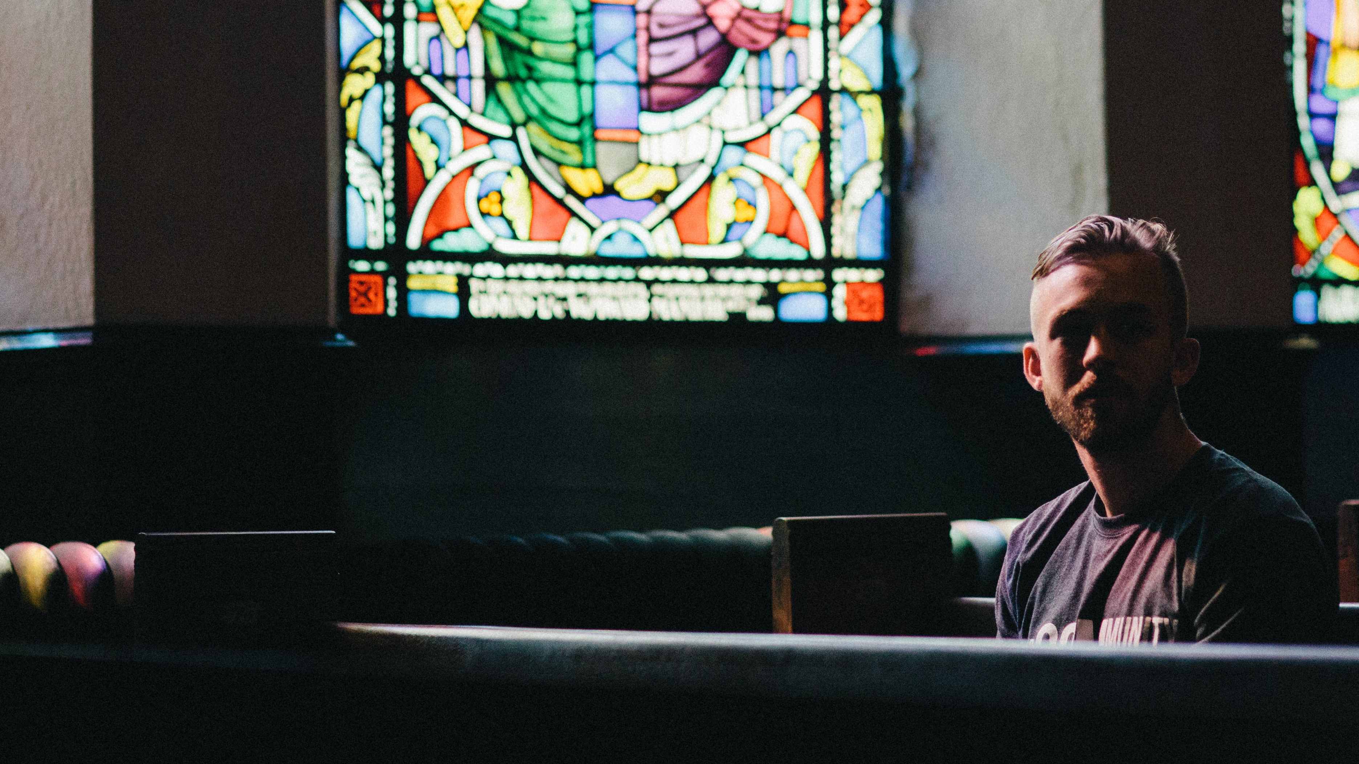
Making Vows is Encouraged
Make vows to the Lord your God, and pay them; Let all who are around Him bring presents to Him who ought to be feared.”
Psalm 76:11

Slide 12
He Reads our Hearts!
Mal. 1:12-14
“But you profane it,
In that you say,
‘The table of the [a]Lord is defiled;
And its fruit, its food, is contemptible.’
13 You also say,
‘Oh, what a weariness!’
And you sneer at it,”
Says the Lord of hosts.
“And you bring the stolen, the lame, and the sick;

Slide 13
He Reads our Hearts!
Mal. 1:12-14
Thus you bring an offering!
Should I accept this from your hand?”
Says the Lord.
14 “But cursed be the deceiver
Who has in his flock a male,
And takes a vow,
But sacrifices to the Lord what is blemished—
For I am a great King,”
Says the Lord of hosts,
“And My name is to be feared among the nations.”

