Slide 1


THE PLEDGE
MOTIVATING WORKER
(Based on “Counsels on Stewardship, chapters 59-61)
Notes:
Presented:
SSD Zoom Meeting (2020)

Slide 2
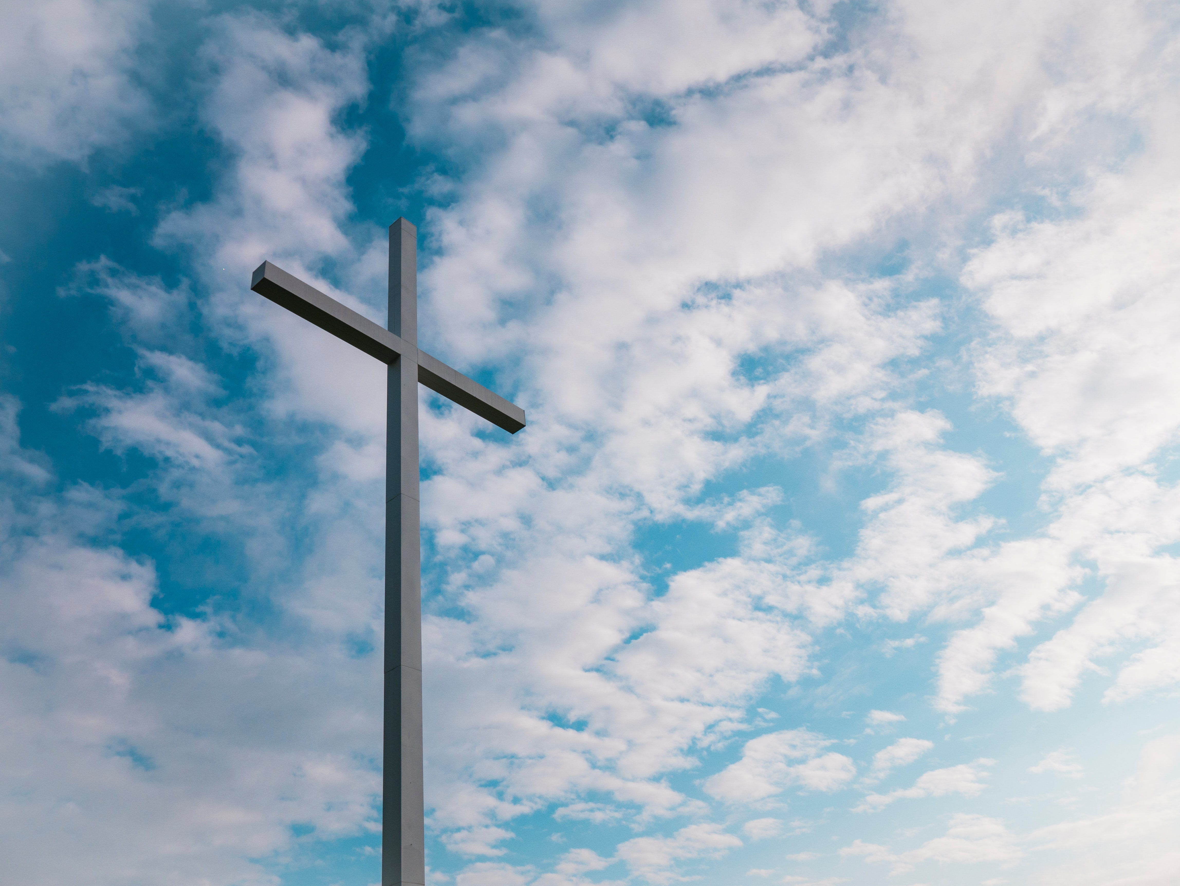
The Pledge
Motivating
Worker

Slide 3
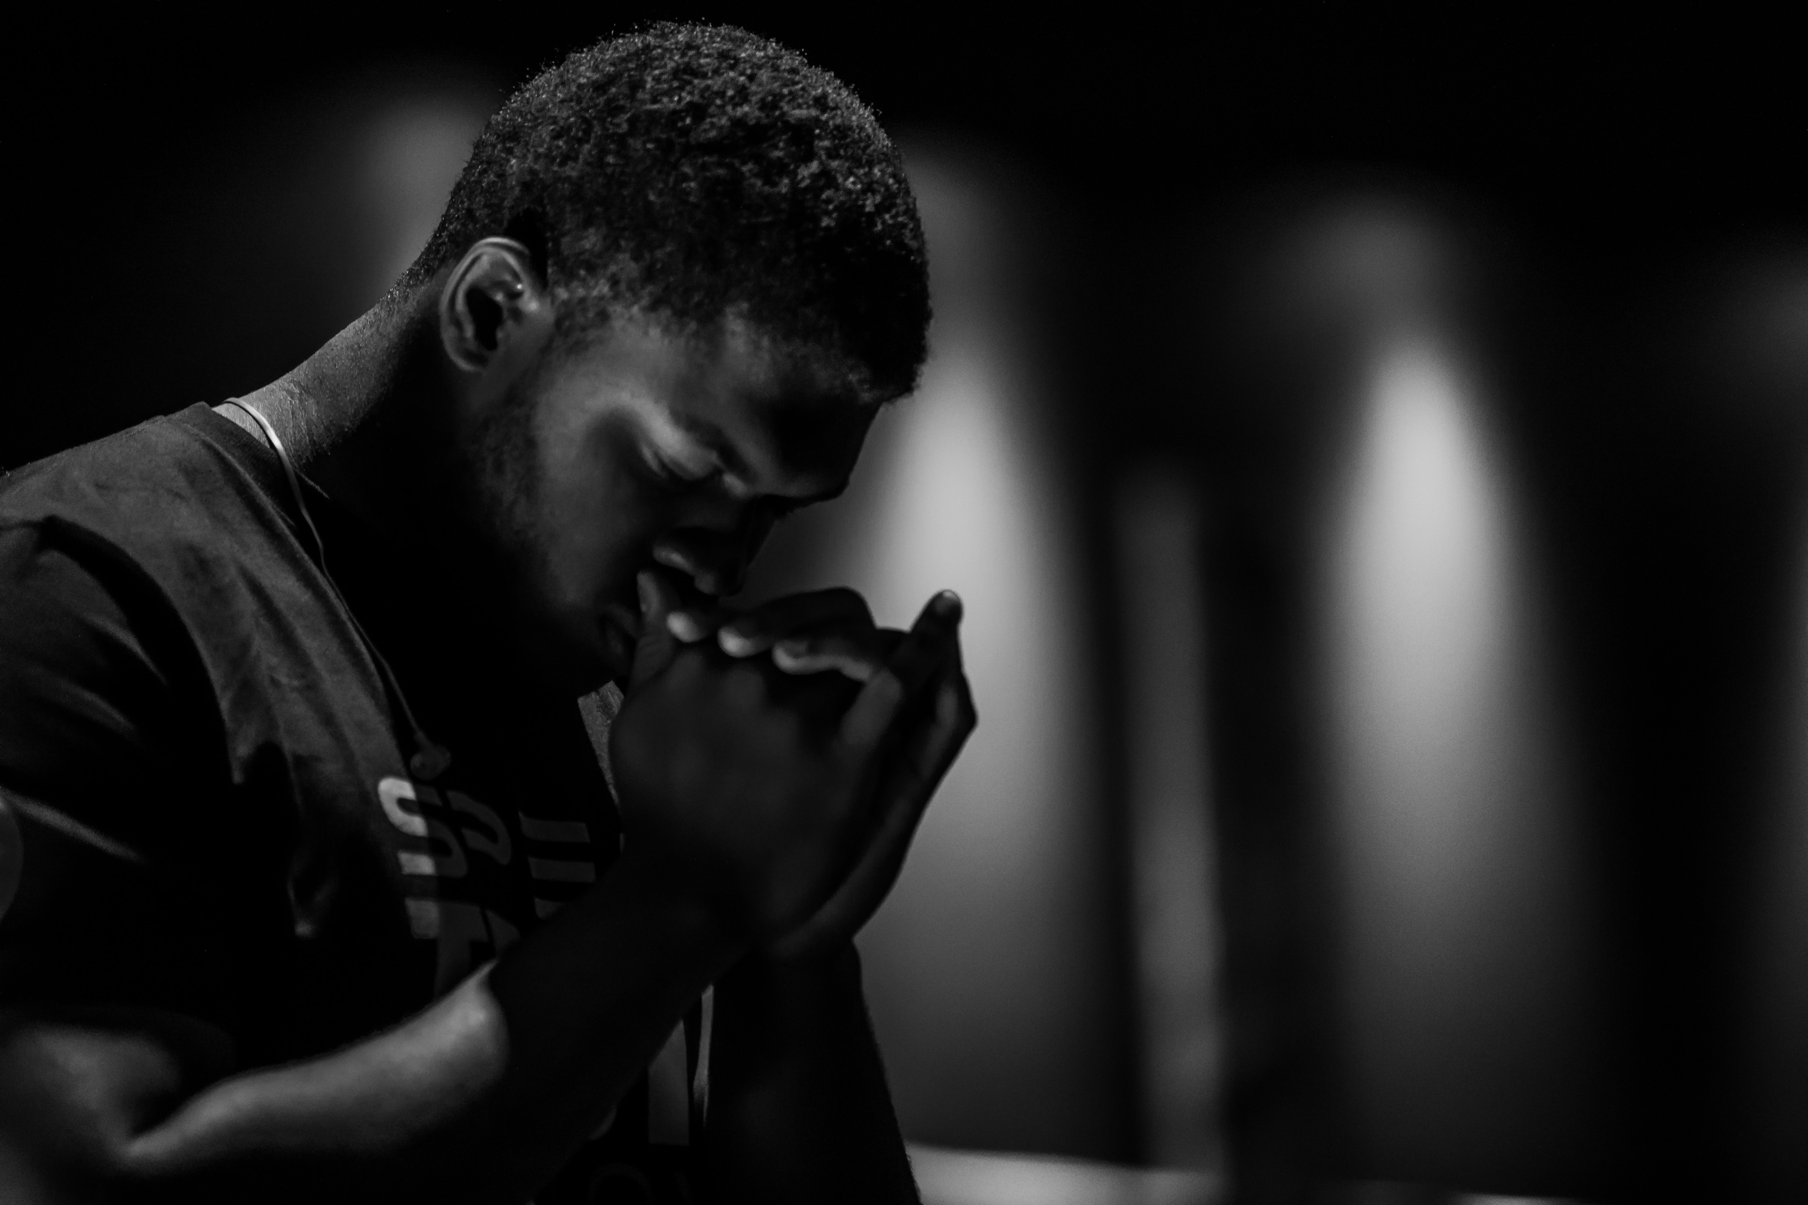
God is Working in Him!
“… Whoever shall awaken the consciences of men, provoking them [2] to good works and [2] a real interest in the advancement of the cause of truth, does not do it of himself, but by the Spirit of God which worketh in him….” Counsels on Stewardship, p. 309.

Slide 4

Not Merely in Answer
to a Human Call
“… Pledges made under these circumstances are of sacred character, being the fruit of the work of the Spirit of God….” Counsels on Stewardship, p. 309.

Slide 5

Heavenly Witnesses
“… Heavenly angels are present on such occasions [of making a pledge]. The love of God and love for souls triumph over selfishness and love of the world….” Counsels on Stewardship, p. 316

Slide 6

The Most Important Message
“… Especially is this the case [heavenly angels are present] when the speaker, in the Spirit and power of God, presents the plan of redemption, laid by the Majesty of heaven in the sacrifice of the cross….” Counsels on Stewardship, p. 316

Slide 7

The Worker’s Reward
“… When these pledges are canceled, Heaven accepts the offering, and these liberal workers are credited for so much treasure invested in the bank of heaven….”
Counsels on Stewardship, p. 309.

