Slide 1
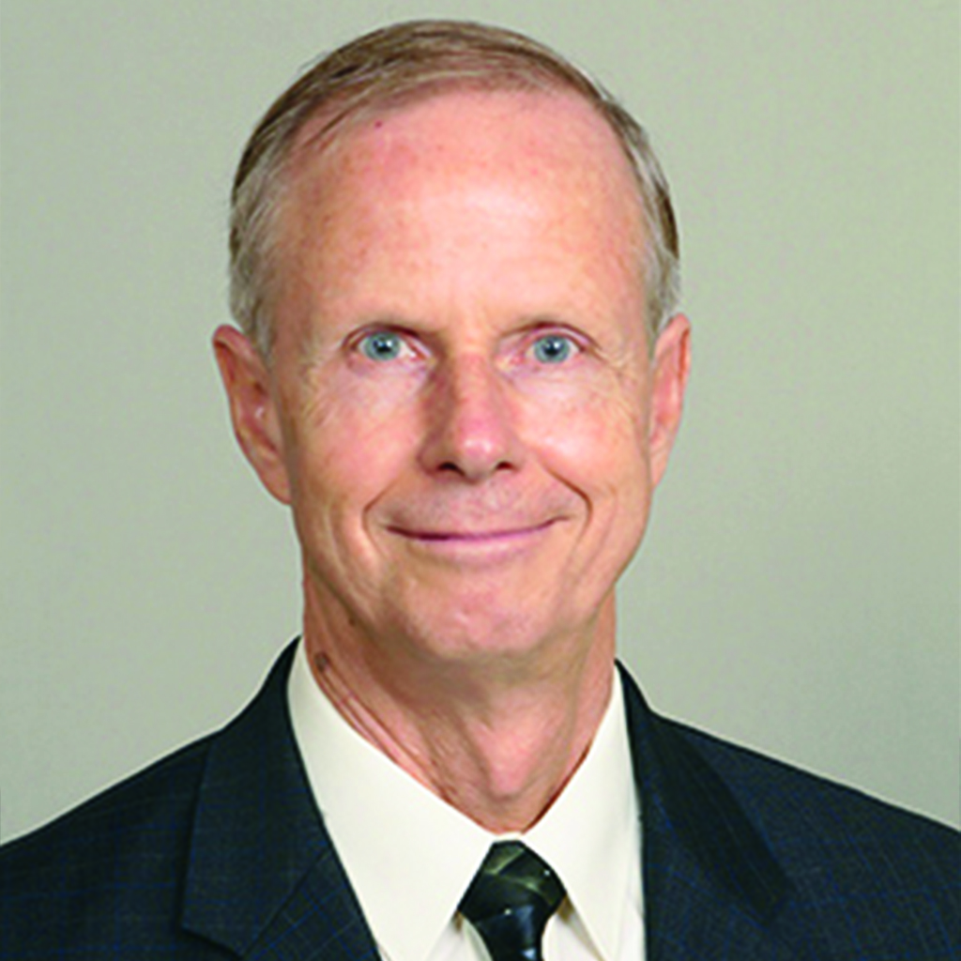
t
Planned Gift Rebuilds
emPLe
unsuspected sources of resources.
DENNIS CARLSON

Slide 2
“And they built and finished it, according to the commandment of the God of Israel, and according to the command of Cyrus, Darius, and Artaxerxes king of Persia. Now the temple was finished”
Ezra 6:14, 15, NIV

Slide 3
Does your ministry need critical funding to accomplish its mission?

Slide 4
The department of Planned Giving & Trust Services may provide an opportunity that could help ensure that future resources that you desperately need will be available.

Slide 5
Planned Giving involves the building of relationships with those who may be able to provide resources by both encouraging families to create a plan, and by sharing the needs of mission with community leaders who have resources.

Slide 6
This outreach can be for both members and those who are not members of the church.

Slide 7
Trust Services is the process by which these planned gifts are given so that the value is maximized for mission.

Slide 8
One example of God’s involvement for the benefit of His mission is found in the book of Ezra.

Slide 9
God had a plan that He had revealed 60 years before.

Slide 10
Who says of Cyrus, ‘He is my shepherd
and will accomplish all that I please;
he will say of Jerusalem, “Let it be rebuilt,” and of the temple, “Let its foundations be laid.”
Isaiah 44:28, NIV

Slide 11
According to the plan, God assigned King Cyrus the task of helping Israel, in spite of Cyrus never becoming a follower of the God of Israel.

Slide 12
This heathen king did exactly what God had prophesied through Jeremiah (Ezra 1:1-5), and through this planned gift ended Israel’s 70 years of captivity.

Slide 13
Darius and Artaxerxes also followed the lead and command of Cyrus to ensure that the temple in Jerusalem was completed.

Slide 14
So the elders of the Jews continued to build and prosper under the preaching of Haggai the prophet and Zechariah, a descendant of Iddo. They finished building the temple according to the command of the God of Israel and the decrees of Cyrus, Darius and Artaxerxes, kings of Persia. The temple was completed on the third day of the month Adar, in the sixth year of the reign of King Darius.
Ezra 6:14, 15

Slide 15
Can this happen today?

Slide 16
Is God still moving the hearts of the “heathen” to support His mission?

Slide 17
A Seventh-day Adventist school had many years previously lost one school campus to a government takeover. After this loss, through the generosity of international donors a new campus was purchased, and a new school eventually built.

Slide 18
Then in 2016, the school received a very unexpected gift from a government authority.

Slide 19
The week before this unexpected gift, the government had taken a portion of another denomination’s church property to build a heathen shrine. So when the entourage of the government authority appeared on the Seventh-day Adventist school campus, the principal was understandably afraid of losing another school to the government.

Slide 20
The principal prayed to God for wisdom to respond in the right way to whatever happened. After asking to see him, the government authority demanded a tour of the campus. Afterwards, the general asked the principal what needs the school had.

Slide 21
After listening to several urgent needs, the government authority went to his vehicle.

Slide 22
Amazingly, he brought $1,000 in cash to give to the principal to help fund the most urgent need. As the general was leaving, he indicated that he would bring more money in the future to help take care of some of the other needs of the school.

Slide 23
There was rejoicing at the school that day for the miraculous power and working of God.

Slide 24
God still works on the hearts of “kings,” or those in authority in our day, and will at the right time do the same for your ministry’s needs.

Slide 25
Present them before God in prayer and trust Him.

Slide 26
The story of Ezra and the rebuilding of the temple in Jerusalem is an amazing story of God’s faithfulness and His ability to work through all sources to provide resources, even through the planned gifts of gentile, heathen kings.

Slide 27
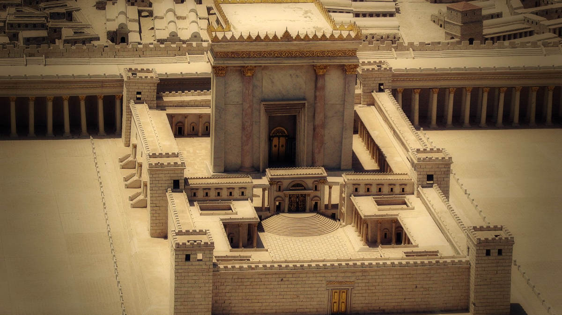
t
UM PRESENTE PLANEJADO RECONSTRÓI O
emPLO
FONTES INESPERADAS DE RECURSOS.
DENNIS CARLSON

