Slide 2
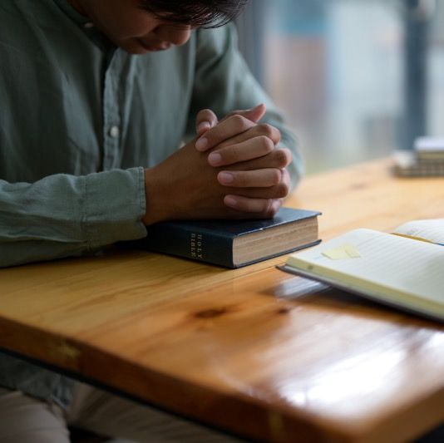
Day 1
My Father’s Business God First by taking
time to worship
Luke 2:41-49

Slide 3
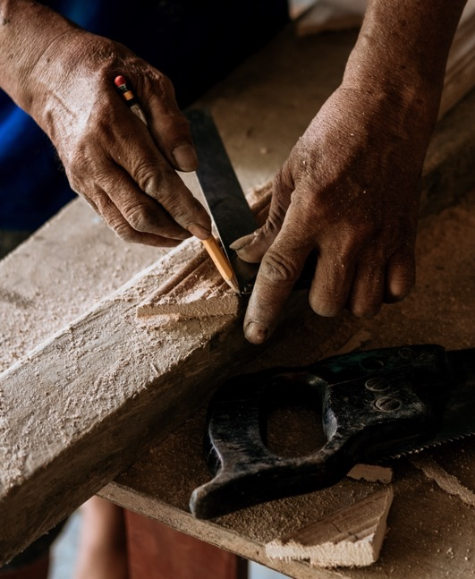
My Father’s
Business

Slide 4
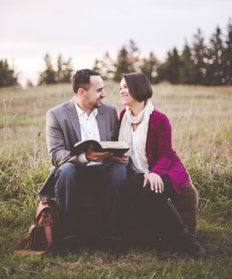
Sitting,
Listening,
Asking

Slide 5
Sitting

Slide 6
Listening

Slide 7
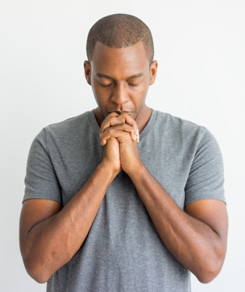
Asking

Slide 8
Seeking
His Presence

Slide 9
Conclusion

Slide 10
Going Deeper
What is your own experience with sitting, listening, and asking during your life’s journey?
What obstacles could be preventing us from engaging in the sitting, listening, and asking experience?
How could we overcome those obstacles?

Slide 11
I Promise: To SET APART the first moments of each day to commune with the Lord through PRAYER, the STUDY of the Bible, the Spirit of Prophecy and the Sabbath School lessons, and in Family Worship.

Slide 12
Day 2
The Walls Must Fall
God First by putting
others first
Luke 19:1-9

Slide 13
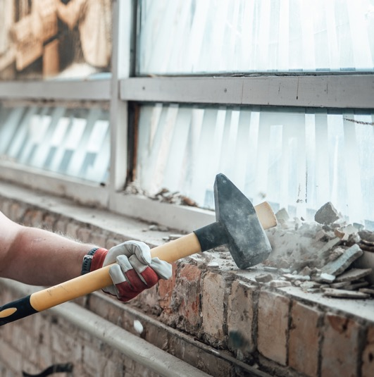
The Walls
Must Fall

Slide 14
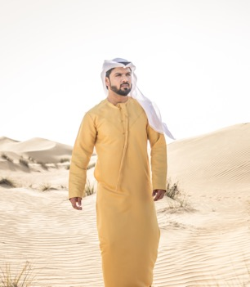
Zacchaeus
and the
Fortified
City

Slide 15
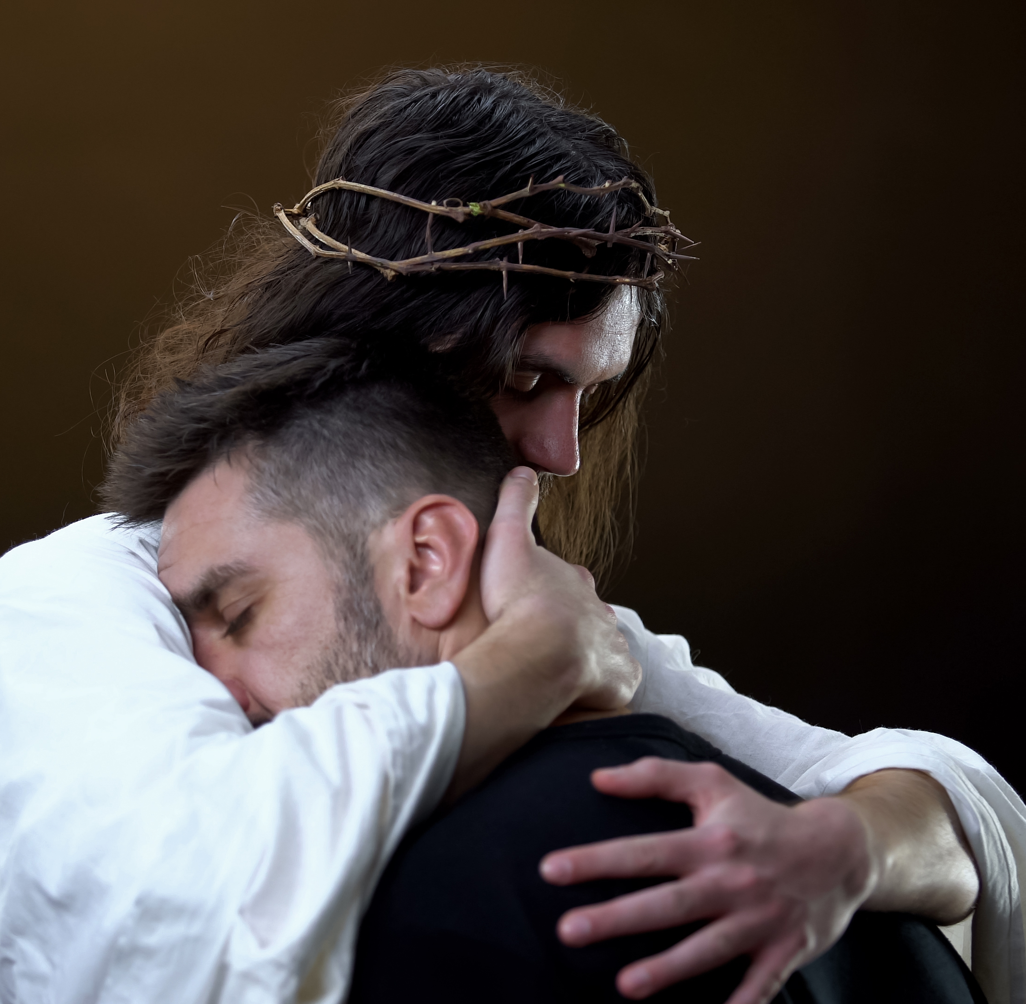
Jesus the
Wall Puller

Slide 16
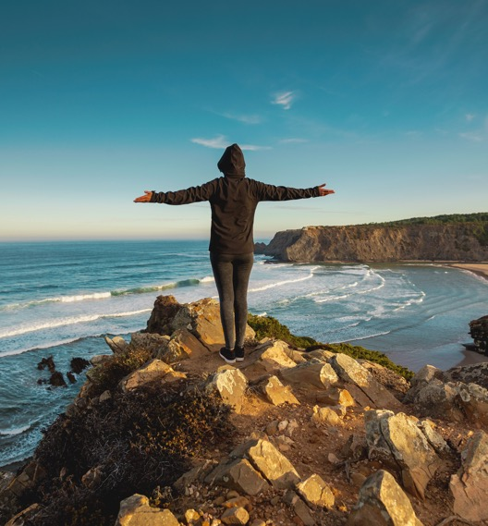
A Life
Without
Walls

Slide 17
Conclusion

Slide 18
Going Deeper
If you are comfortable, share how a broken relationship was restored.
How did you feel about this experience?
Is someone currently struggling to mend and improve some relationships? Would you like to ask for God’s help?

Slide 19
I Promise: To IMPROVE my RELATIONSHIPS: growing in faithfulness, forgiveness, and loving by principle.

Slide 20
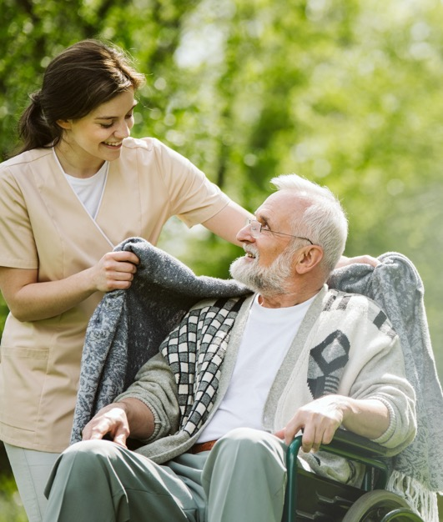
Day 3
Bought With a Price
God First by caring
for others
Luke 9: 10, 28

Slide 21
Principles
of Health

Slide 22
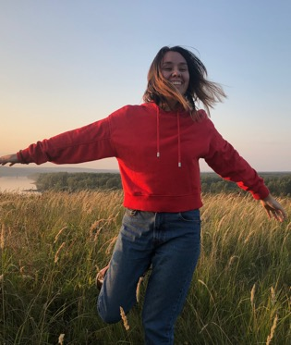
Stewardship
and Health

Slide 23
House
Sitters

Slide 24
Conclusion

Slide 25
Going Deeper
How does the thought that God bought you for a price affect how you treat your body in your daily life?
Can you identify some of Ellen White’s instructions on health and nutrition that have been proven correct by modern science.
What is the importance of discipline in your Christian life?

Slide 26
I Promise: To ESTABLISH one new HEALTHY HABIT, to better serve the Lord with my mind:

Slide 27
Day 4
Facilitators of a
New Vision
God First by
ministering to others
Luke 9: 10, 28

Slide 28
Facilitators
of a New
Vision

Slide 29
The
Passing-by
Mode

Slide 30
The
Silencing
Mode

Slide 31
The
Facilitating
Mode

Slide 32
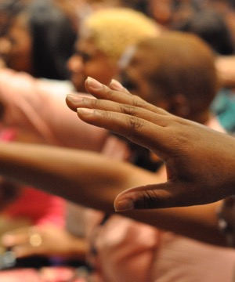
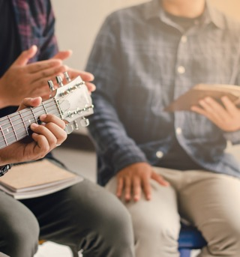
The Praising
Together Mode

Slide 33
Conclusion

Slide 34
Going Deeper
Share an experience of you helping someone to embrace a new vision for life.
How can we function more in the “Facilitating Mode” during this season of social distancing?
Who would you like to bring to Jesus? Share his or her name for intercession.

Slide 35
I Promise: To DEVOTE regular time each week to WORK For God, spreading the good news to others through Bible studies, small groups, etc. (TMI).

Slide 36
Day 5
The God First Day
God First by keeping
the Sabbath
Luke 6:6-10

Slide 37
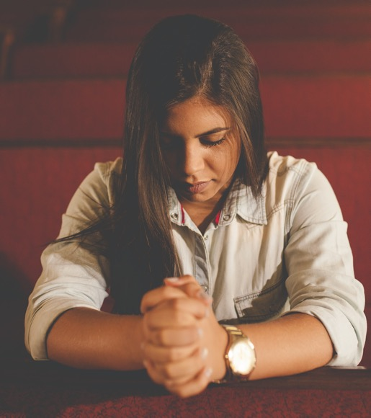
The God
First Day

Slide 38
Cultivating
the God First
Mindset

Slide 39
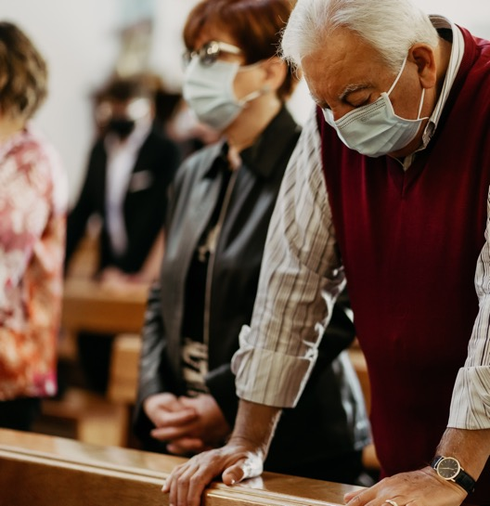
God First
Through
Collective
Worship

Slide 40
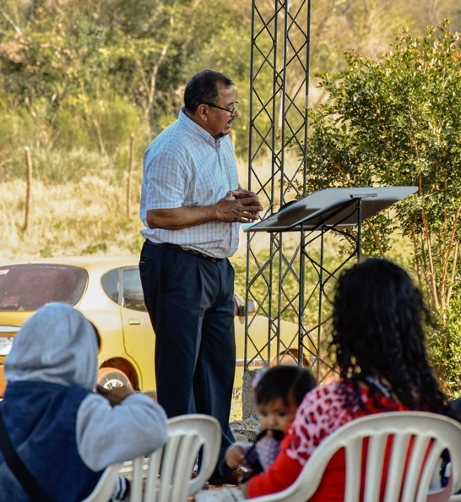
God First
Through
Ministry

Slide 41
Conclusion

Slide 42
Going Deeper
What is preventing you from experiencing the Sabbath as the God First day?
In what ways would you like to enrich your Sabbath experience?
Is there anyone who is facing some forms of challenges or persecutions to keep the Sabbath? Share his/her name for intercession.

Slide 43
I Promise: To KEEP the SABBATH, preparing for it accordingly on Friday, keeping its limits, right thoughts, and activities.

Slide 44
Day 6
The Deal of a Lifetime
God First through the
practice of tithing
Luke 6:6-10

Slide 45
The Deal
of a Lifetime

Slide 46
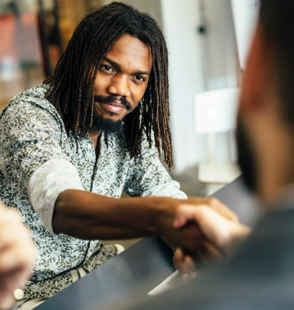
A Great
Deal

Slide 47
A Broken
Deal

Slide 48
A Terrible
Outcome

Slide 49
Conclusion

Slide 50
Going Deeper
Share about God’s faithfulness, in your life, regarding His promise, “I give you the ability to produce wealth.”
What makes it hard for us to uphold our share of the deal?
Would you like the group to intercede for you as you choose to respect Jesus as Owner, Provider, and Lord?

Slide 51
I Promise: To FAITHFULLY RETURN the Lord’s TITHE (10% of my income).

Slide 52
Day 7
Generous… Even
When it Hurts
God First through
sacrificial offerings
Luke 6:6-10

Slide 53
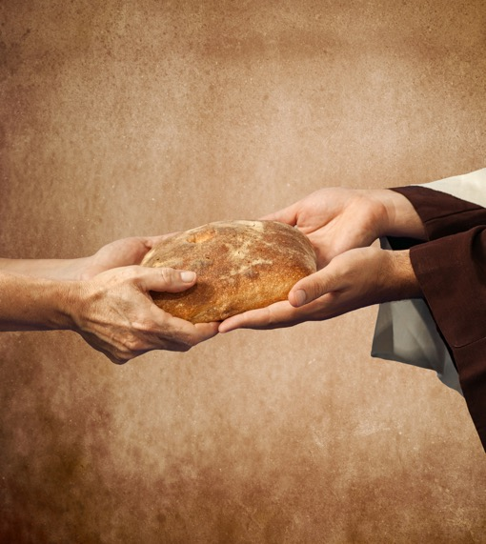
Generous…
Even When
it Hurts

Slide 54
Offerings
During a
Crisis

Slide 55
Sacrificial
Giving

Slide 56
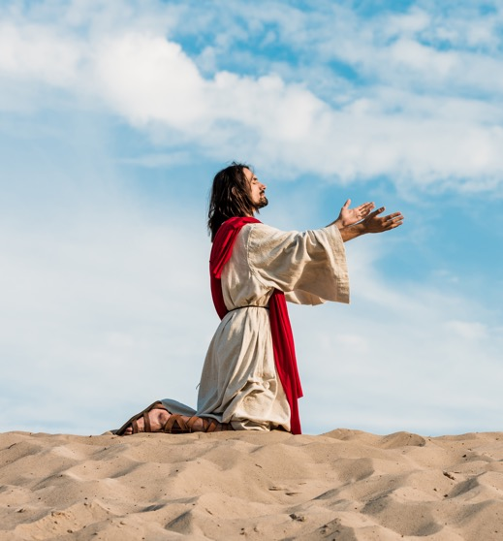
Giving
Out of Love

Slide 57
Conclusion

Slide 58
Going Deeper
Have you ever been inspired by someone with a sacrificial spirit?
What are some challenges that may confront us in our attempts to remain generous in our offerings during this current season of life?
How would you like to grow as a giver in whom God delights?

Slide 59
I Promise: To DEDICATE a percentage ( %) of my income as a regular OFFERING to the Lord.

