Slide 1
FUNDAMENTAL IDEAS
OF CHRISTIAN STEWARDSHIP
by Roberto Herrera

Slide 2
Biblical stewardship
Biblical stewardship is based on the idea that God created human beings and invited them to oversee His creation and manage His resources. This implies that stewardship is assigned to humans by God as an integral and comprehensive lifestyle. In addition, it leads us to understand who God is, what He has done, who we are, and how we should live. We’ll uncover some biblical concepts which delineate the fundamental lifestyle of a Christian steward.

Slide 3
01. What important truths does the concept of God as Creator teach us?
Read Genesis 1:1; Psalm 24:1, 2; and Revelation 4:11.
“Worthy are you, our Lord and God, to receive glory and honor and power, for you created all things, and by your will they existed and were created.”
Revelation 4:11

Slide 4
a) This biblical concept shows that God is the unique and incomparable Creator.
Therefore, we are to worship, honor, and obey Him. We ought to place Him first in our lives and render primary allegiance to Him.

Slide 5
b) This concept also shows that God is Sovereign, meaning that He is the Supreme, All-powerful, Self-sufficient Ruler.

Slide 6
c) This concept reminds us that God owns all things, unlike human beings, who have limits when managing their resources, whether tangible or intangible.

Slide 7
2. What does the Bible tell us about how God created human beings in the image and likeness of God?
Read Genesis 1:26, 27; 5:1, 2; Colossians 1:15;
and Hebrews 1:3.
The Son is the image of the invisible God,
the firstborn over all creation.
Colossians 1:15

Slide 8
a) This concept shows that God created humans to represent Him. However, they did not live up to that expectation. They rebelled against God
(Gen. 3:1-19; Rom. 3:23).

Slide 9
b) This concept also shows that the divine image lost by human beings can be restored through Jesus, the Son of God, who became man
(Gal. 4:4). Jesus is the only perfect image of the invisible God! He is the splendor of God’s glory, the expression of the divine nature, and the model for human beings wanting to know Him
(Col. 1:15; Heb. 1:3).

Slide 10
3. Human beings were created to have a personal and intimate relationship with God.
Read Deuteronomy 6:5; 10:12; and Matthew 22:37, 38.
“Love the Lord your God with all your heart and with all your soul and with all your strength”
Deuteronomy 6:5

Slide 11
a) This concept reminds us that God wanted to have a personal and intimate relationship with human beings; therefore, He formed humans with His hands and breathed life into their nostrils. God’s purpose was for a long and lasting relationship, but that was interrupted by sin. Humanity’s rebellion led to separation from God (Isa. 59:2). However, through Christ (the God-man) and His incarnation, humans can be reconciled to their Creator.

Slide 12
b) This concept also reminds us that God is interested in this world, and He carries out His plan to rescue humanity. We are to seek God in an intimate and personal way and represent Him daily. People of all ages can communicate with God through daily Bible study, prayer, praise, and worship.

Slide 13
4. What are the implications OF the statement “God created man to oversee His creation according to His directives”?
“Then God said, “Let us make mankind in our image, in our likeness, so that they may rule over the fish in the sea and the birds in the sky, over the livestock and all the wild animals,[a] and over all the creatures that move along the ground.”
Genesis 1:26
Read Genesis 1:26-29; Psalm 8:3-8;
and Philippians 2:5-11.

Slide 14
a) This concept reminds us that because God endowed human beings with the authority over the lower beings and the rest of creation, humans were to represent Him, managing God’s affairs on earth. After humans sinned, they regained their position of honor and trust through the death and resurrection of Christ. In Christ, humans can once again live as God’s agents, managing His affairs, ruling in partnership over God’s resources, and giving first place to Christ as Owner and Lord.

Slide 15
b) This concept reminds us that there are limits to our right to control and use God’s property (Gen. 2:15-17; 1 Cor. 4:7). Stewards are held accountable for their stewardship by God, who is the Sole Owner of all things (Rom. 14:12;
Luke 16:2).

Slide 16
In brief, human beings were created to worship God and to be His loyal stewards, fully committed
to His will.

Slide 17
5. What does it mean that human beings were created to interact in relationship and in equality with one another?
Read Genesis 2:18-24; John 13:34;
and Romans 12:10, 16.
Be devoted to one another in love.
Honor one another above yourselves.
Romans 12:10

Slide 18
a) This concept reminds us that God created everyone to be part of the greater human race. The Bible shows that human beings complement each other and are complete in Christ. Sin, on the other hand, has separated and damaged this relationship, resulting in a life of selfishness, making the world a difficult place in which to live.

Slide 19
b) This concept also reminds us that through the church, which is the body of Christ, God restores human beings, thus inviting them to a life of discipleship. We are to depend on Him and be accountable to Him and each other. This connection enables the church to function as a united body growing in the image of Jesus Christ.

Slide 20
Fb
Be
Tw
What we take away from this brief study is that biblical stewardship gives meaning to human existence by offering a personal relationship with God, the Creator, and the Owner of everything.
Accepting who God is and how we were created by Him gives us true knowledge of our origin, purpose, and future life.
The biblical stewardship message provides the basis for a meaningful existence.

Slide 21
TWO IMPORTANT QUESTIONS TO BE ANSWERED ARE:
1
Will you accept that God, through Christ as Creator, has rights over every aspect of your life?
2
Are you willing to become a disciple of Christ, integrating His teachings into every area of your life?

Slide 22
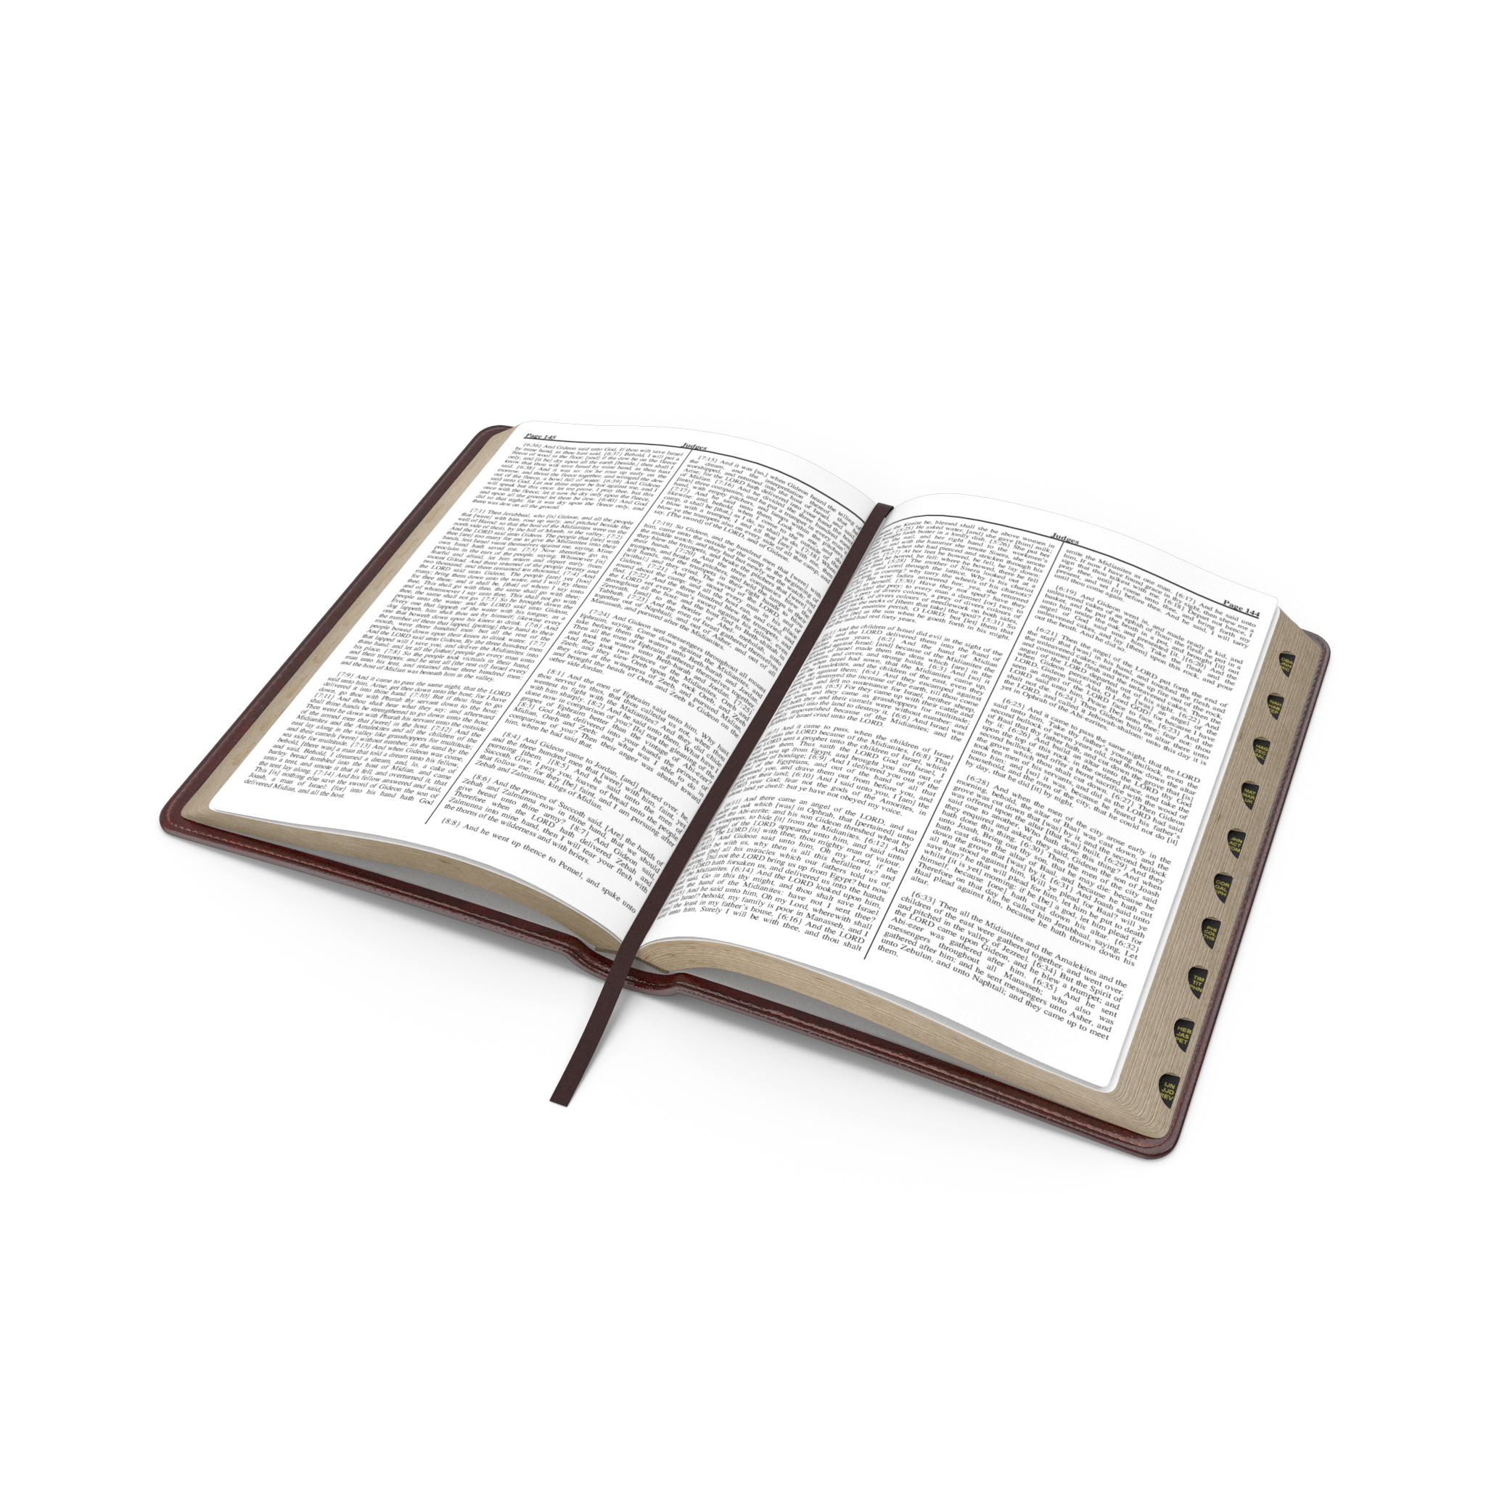
For further study
and confirmation,
read 2 Corinthians 5:17 and Galatians 2:20.

Slide 23
Roberto Herrera,
Stewardship Director for the Inter-American Division of Seventh-day Adventists.

