Slide 1

Stewardship in a Global Crisis
Inter-European Division / Stewardship Department

Slide 2
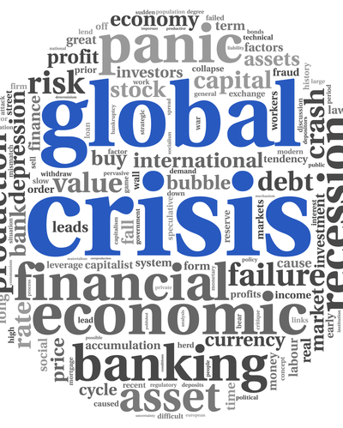
1. What does the global crisis teach us?

Slide 3
How weak we are as human beings:
Reveals the reality that we are not really in control;
Shows what we are afraid of;
Shows us what is important and what is vanity.

Slide 4

2. A sermon for all ages, a sermon for a time of global crisis.

Slide 5
We must begin reading the Sermon on the Mount by listening carefully to the ending of it and linking this ending to the beginning: “Therefore whoever hears these saying of Mine and does them, I will like him to a wise man” (Matt. 7:24); it is “blessed” (Matt. 5:1-12).

Slide 6

3. It is a command, not a suggestion: stop worrying!

Slide 7
Jesus repeated the command three times: “Do not worry . . .” (Matt. 6:25, 31, 34).
Worry is not our friend, and panic is not our way (Prov. 24:10).
“Worry doesn’t release tomorrow of its sorrows, it empties today of its strength” (Corrie ten Boom).
“It is not the will of God that His people should be weighed down with care” (SC, 122).

Slide 8

4. Anxiety negatively impacts our health.

Slide 9
A few effects of chronic worry on our bodies: fast heartbeats, fatigue, headaches, inability to concentrate and focus, irritability, muscle aches …
Worry can lead to more serious physical consequences: suppression of immune system, short-term memory, coronary artery disease, hearth attack …
“The continual worry is wearing out the life forces. Our Lord desires them to lay aside this yoke of bondage” (DA, 330).

Slide 10

5. Anxiety affects our spirituality.

Slide 11
When you worry, you are not enjoying your relationship with God.
Worry will impact the way you relate with others.
Anxiety will not produce fruits in our life.

Slide 12
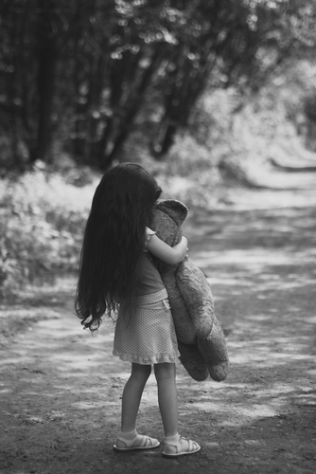
6.The bad news— we are all worried.

Slide 13
We are all sinners, we are all natural worriers, and some of us are chronic worriers.
We are worriers because we are living in a broken and fallen world.
Neither was the apostle Paul exempt from this experience: “The trials and anxiety that Paul had endured had preyed upon his physical powers” (AA, 488).

Slide 14

7. What is worry, according to the Bible?

Slide 15
Worry is a spiritual issue, a response to God himself (Matt. 6:25-34).
The Greek word used is merimnao; it means “a distracted mind” or a “doubled mind.” The same word used by Jesus to Martha (Luke 10: 38-42).
Anxiety is over-concern; it means “over-concerned about something more than the Kingdom of God” (Dick France).

Slide 16
Jesus is not telling us not to be concerned about things. He is telling us not to be over-concerned.
The essence of worry is an attempt to find your hope, comfort, and meaning in something that is temporal and fleeting (this is idolatry).

Slide 17

8. False ambition: own material security.

Slide 18
Jesus wishes to treat in parallel the two forms of material needs that humans have: food and clothing (“What you will eat, or drink … what you will wear” [Matt. 6:25]).
Jesus’ sermon is still illustrated today in the advertisements that we meet everywhere. Most refer to these needs.
Most commercials have as their objective the well-being of the body.

Slide 19
During this crisis, the main reason why people panic is the lack of food (pictures with empty shelves create panic, although in Jesus' day, 80% of the population lived from one day to another).
Jesus neither denies nor disregards the needs of the body, but only emphasizes that excessive concern for material comfort is wrong.
“God does not condemn prudence and foresight in the use of the thing of this life, but the feverish care, the undue anxiety, with respect to worldly things is not in accordance with His will ” (CS, 159).

Slide 20

9. How does Jesus change the perspective from false to true ambition?

Slide 21
Jesus uses three dimensions through which anxiety can be managed.

Slide 22

10. The intellectual dimension

Slide 23
Logic has an irresistible force and is emphasized in verse 27: “Who of you by worrying can add a single hour to his life.”
Worrying can only shorten life; by no means can it extend it.
If we leave this issue in God’s hands (it cannot be otherwise), wouldn’t it be wise to trust Him in smaller things, as with food and clothing?

Slide 24

11. The emotional dimension

Slide 25
Often in the Old Testament, God’s providence is expressed through the care He has for the other beings: animals, birds (Ps.104; Job 38).
The first example is from the bird world and the second from the plant world: the birds of the sky and the lilies in the valley.
Luther said: “It is a shame for us, and one that we can not escape easily, that in the Gospel a helpless sparrow must become a theologian and preacher to the wisest of people.... Whenever you listen to a nightingale you listen to an eminent preacher.”

Slide 26
“Wonderful lilies, oh, how you show us our mindless agitation” (Spurgeon).
Each argument ends with the question: Are you not of more value than they? (v. 26).
We are a priority for God, a value that cannot be expressed, the life of His Son.

Slide 27
Jesus resorts to the emotional dimension because our problem is not with theology, but with desires that cause theology not to be heard.
The cross of Golgotha is not a sermon, but a demonstration of His love.
The expression “of little faith” appears five times in Matthew’s epistle, and each time it refers to the apostles (Matt. 6:30).

Slide 28

12. The practical dimensions

Slide 29
The antidote for anxiety is to “seek first the Kingdom of God and His righteousness” (v. 33).

Slide 30

13. What does it mean to “seek first the Kingdom of God and His righteousness” from a practical perspective?

Slide 31
“His righteousness” means to do everything He has told us in this sermon and implies also our social, missionary, and spiritual responsibility.
“Worry is blind and cannot discern the future. But Jesus sees the end from the beginning. In every difficulty He has His way prepared to bring relief. Our heavenly Father has a thousand ways to provide for us, of which we know nothing. Those who accept the one principle of making the service and honor of God supreme will find perplexities vanish, and a plain path before their feet” (DA, 330).

Slide 32

14. Questions instead of conclusions

Slide 33
If concern is a spiritual barometer, do I belong to the group Jesus called “of little faith”?
Jesus’ sermon has in its center the prayer, “Our Father which art in Heaven…”; to what extent is prayer in the center of my life?
During a crisis we are tempted to think only about ourselves, our family, our health. To what extent does the Sermon on the Mount find an echo in the sense of us being close to those who are suffering or experiencing difficulties?

Slide 34
Jesus' statements are radical; there are no half measures. Is God in the first place of my life or not, in terms of devotion, finances (whether I am or am not faithful in tithes and offerings), the usual aspects of life (clothing, food), and relationships?
The global crisis is the most appropriate opportunity to analyze our priorities objectively.

