Slide 1
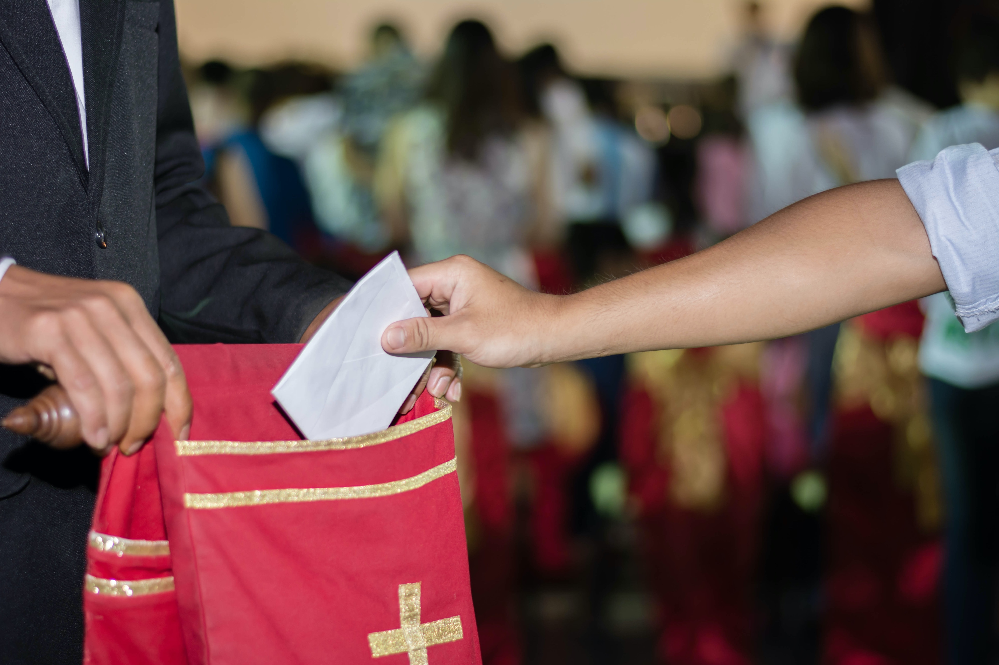
TITHE: A BIBLICAL FOUNDATION
God as the Creator and Possessor
Marcos Faiock Bomfim
GC Stewardship Ministries

Slide 2
TITHE PRINCIPLE: ESTABLISHED IN EDEN
God: Creator and Possessor (Owner) of Everything (Gen. 1; 14:19)
The Lord: the Giver and Provider of all things (Gen. 1:27-30)

Slide 3
TITHE PRINCIPLE: ESTABLISHED IN EDEN
Mankind: established as managers (dominion – rada/oikonos) – Gen. 1:26, 28
There was a restriction: as managers, they cannot dispose of all that belongs to the Owner.
“And the Lord God commanded the man, saying, ‘Of every tree of the garden you may freely eat; but of the tree of the knowledge of good and evil you shall not eat, for in the day that you eat of it you shall surely die (Gen. 2:16-17).”

Slide 4
TITHE PRINCIPLE: ESTABLISHED IN EDEN
Some things are kept by the owner to be used at His discretion.
Apparently, those things are available to consumption
(Like what happens with the Sabbath)
Fear of lacking resources may lead some to temptation
Trust in the Provider will lead to obedience

Slide 5
TITHE PRINCIPLE: ESTABLISHED IN EDEN
“Then the Lord God took the man and put him in the garden of Eden to tend and keep it. And the Lord God commanded the man, saying, ‘Of every tree of the garden you may freely eat; but of the tree of the knowledge of good and evil you shall not eat, for in the day that you eat of it you shall surely die’.” Gen. 2:15-17.
“… Here was the test of their gratitude and loyalty to God.” CS, 65.

Slide 6
IT IS HOLY
“And all the tithe of the land, whether of the seed of the land or of the fruit of the tree, is the Lord’s. It is holy [qodes = dedicated, consecrated] to the Lord. … And concerning the tithe of the herd or the flock… the tenth one shall be holy to the Lord.”
Lev. 27:30, 32.

Slide 7
A PRE-LEVITICAL PRACTICE
Abraham gave it (Gen. 14:20)
He recognizes the Lord as Possessor of heaven and earth (Gen. 14:22).
Jacob promised to give it (Gen. 28:22)

Slide 8
PRACTICE REINFORCED IN THE NT
“… For you pay the tithe of mint and anise and cumin, and have neglected the weightier maters of the law: justice and mercy and faith. These you ought to have done, without leaving the others undone.” Matt 23:23.
“Even so, the Lord has commanded that those who preach the gospel should live from the gospel.” 1 Cor. 9:14.

Slide 9
TITHE IS AN OFFERING
“For the tithes…. which they offer up as a heave offering to the Lord…” Num. 18:24
“… He taught them to devote a tithe of their possessions to the service of the tabernacle. This was a special offering, for a special work…”
Counsels on Stewardship, 71.

Slide 10
IT IS A SYSTEMATIC OFFERING
What is the system?
Proportional system

Slide 11
A SPECIFIED PROPORTION
From the Hebrew maaser, an exactly a tenth (Lev. 27:32)

Slide 12
IT IS REGULAR
What should establish the tithe giving regularity?
Gratitude? A specific day?
“Honor de Lord with your possessions, and with the firstfruits of all your increase.” (Prov. 3:9)
Every time there is an income.

Slide 13
IT IS ALL INCLUSIVE
“And all the tithe of the land… whatever passes under the rod…” Lev. 27:30-32 (see Gen. 14:20).
After any income or increase

Slide 14
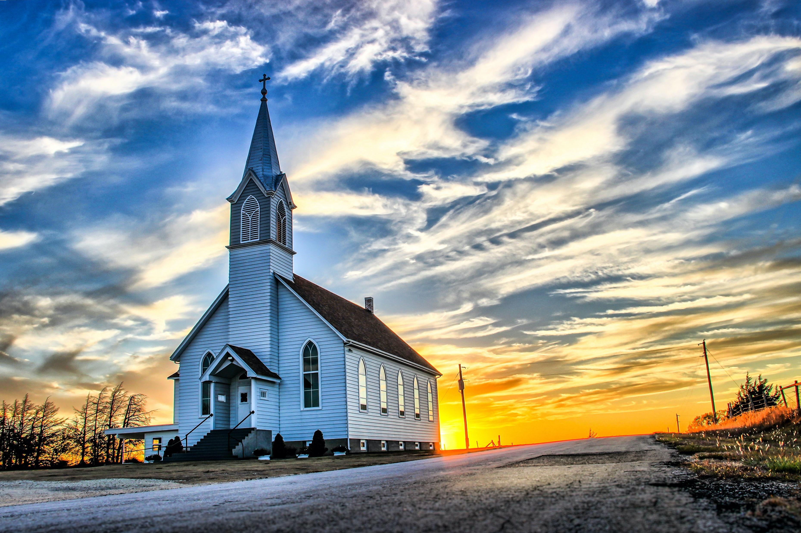
THERE IS A SPECIFIED PLACE FOR DELIVERING IT
“But you shall seek the place where the Lord your God chooses, out of all your tribes, to put His name for His dwelling place; and there you shall go. There you shall take your burnt offerings, your sacrifices, your tithes…” Deut. 12:5, 6.

Slide 15
THERE IS A SPECIFIED PLACE FOR DELIVERING IT
“’Bring all the tithes into the storehouse, that there may be food in My house, and try Me now in this,’ says the Lord of hosts, ‘If I will not open for you the windows of heaven and pour out for you such blessing that there will not be room enough to receive it.’” Mal. 3:10.

Slide 16
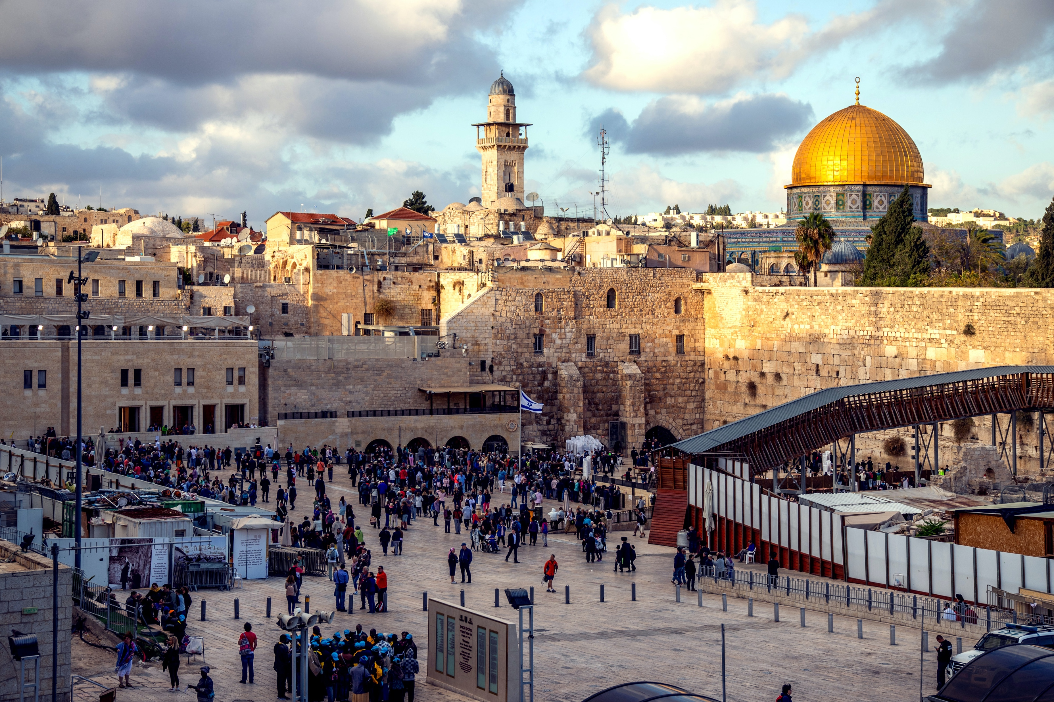
A SPECIFIED USE
“For the tithes of the children of Israel, which they offer up as a heave offering to the Lord, I have given to the Levites as an inheritance; therefore I have said to them, ‘Among the children of Israel they shall have no inheritance.’” Num. 18:24 (emphasis supplied).

Slide 17
A SPECIFIED USE
“Do you not know that that those who minister the holy things eat of the things of the temple, and those who serve at the altar partake of the offerings of the altar? Even so the Lord has commanded that those who preach the gospel should live from the gospel.” 1 Cor. 9:13, 14 (emphasis supplied).

Slide 18
IT SHOULD BE GIVEN TO THE LORD
“For the tithes…. which they offer up as a heave offering to the Lord…” Num. 18:24 (Emphasis supplied).

Slide 19
A SIGN OF REVIVAL AND REFORMATION
“… Return to Me, and I will return to you,’ says the Lord of hosts. But you said, ‘In what way shall we return?’…. In tithes and offerings….’” Mal. 3:7-8.

Slide 20
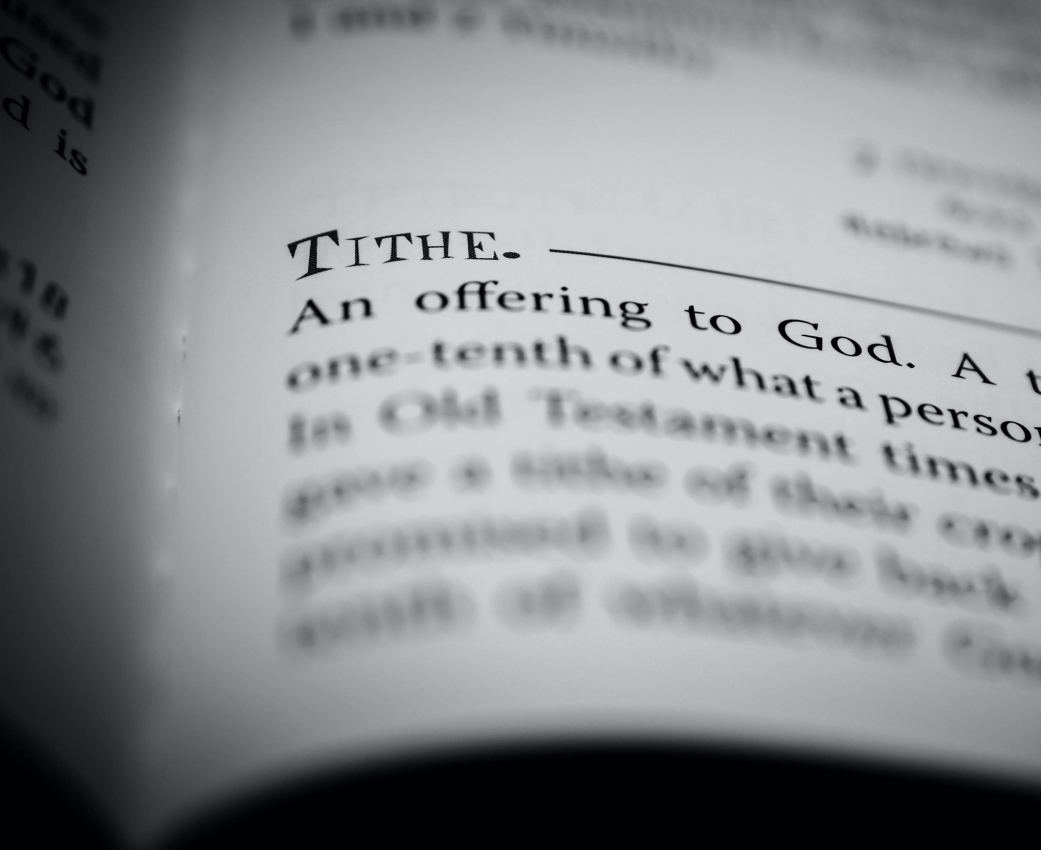
PART OF NEHEMIAH’S REVIVAL ENDEAVOR
“I also realized that the portions for the Levites had not been given them…
So I contended with the rulers…
Then all Judah brought the tithe of the grain and the new wine and the oil to the storehouse.” Neh. 13:10-12.

Slide 21
REFRAINING FROM GIVING IT CONSTITUTES SERIOUS MORAL FAILURE
“… ‘In what way have we robbed You?’ In tithes and offerings. You are cursed with a curse, for you have robbed Me, even this whole nation.” Mal. 3:8, 9.

Slide 22
IT IS PART OF AN INVITATION FROM GOD TO TEST HIM
Notes:
NOTES received from Dennis Carlson on Jan. 12, 2021.
n the SS Bible Study Guide this morning there was a very interesting comparison made by the lesson author. When considering the unlimited offer of God to wicked King Ahaz to select a sign and the king rejected God’s offer.
Isa 7:11 “Ask a sign of the LORD your God; let it be deep as Sheol or high as heaven.
Isa 7:12 But Ahaz said, I will not ask, and I will not put the LORD to the test.”
The lesson author compared this unlimited offer of God to God’s unlimited offer to every human in Malachi.
"Bring the full tithe into the storehouse, so that there may be food in my house, and thus put me to the test, says the LORD of hosts; see if I will not open the windows of heaven for you and pour down for you an overflowing blessing." Malachi 3:10
When we humans reject God’s unlimited offer of blessings and refuse to trust God in the returning of a faithful, systematic, proportional, tithe and offering we are doing the same as wicked king Ahaz in rejecting God as one who can not be trusted to be active actively blessing our lives. We in essence believe that we must do it ourselves by our own works not by faith in the power and blessings of God.
I had not connected these two texts before. We tend to judge Ahaz as being a wicked unfaithful king. Yet, are we not just as guilty when we allow our local customs, culture, and traditions to take precedence over the clear offer of God of abundant blessings to those who choose to test Him in these important areas (tithe and offering) of stewardship?.
This could also be applied to Planned Giving when we think that we need to follow the local customs, culture, and traditions that dictate that we must give to our children all of our possessions (assets) and refuse to give any to the support of God’s mission on earth.
I would be interested in your thoughts.
Dennis Carlson

Slide 23
GOD INVITES WICKED KING AHAZ TO TEST HIM
“Moreover the Lord spoke again to Ahaz, saying, ‘Ask a sign for yourself from the Lord your God; ask it either in the depth or in the height above.’ But Ahaz said, ‘I will not ask, not will I test the Lord!’” Isaiah 7:10-12 (Emphasis supplied)
Notes:
NOTES received from Dennis Carlson on Jan. 12, 2021.
In the SS Bible Study Guide this morning there was a very interesting comparison made by the lesson author. When considering the unlimited offer of God to wicked King Ahaz to select a sign and the king rejected God’s offer.
Isa 7:11 “Ask a sign of the LORD your God; let it be deep as Sheol or high as heaven.
Isa 7:12 But Ahaz said, I will not ask, and I will not put the LORD to the test.”
The lesson author compared this unlimited offer of God to God’s unlimited offer to every human in Malachi.
"Bring the full tithe into the storehouse, so that there may be food in my house, and thus put me to the test, says the LORD of hosts; see if I will not open the windows of heaven for you and pour down for you an overflowing blessing." Malachi 3:10
When we humans reject God’s unlimited offer of blessings and refuse to trust God in the returning of a faithful, systematic, proportional, tithe and offering we are doing the same as wicked king Ahaz in rejecting God as one who can not be trusted to be active actively blessing our lives. We in essence believe that we must do it ourselves by our own works not by faith in the power and blessings of God.
I had not connected these two texts before. We tend to judge Ahaz as being a wicked unfaithful king. Yet, are we not just as guilty when we allow our local customs, culture, and traditions to take precedence over the clear offer of God of abundant blessings to those who choose to test Him in these important areas (tithe and offering) of stewardship?.
This could also be applied to Planned Giving when we think that we need to follow the local customs, culture, and traditions that dictate that we must give to our children all of our possessions (assets) and refuse to give any to the support of God’s mission on earth.
I would be interested in your thoughts.
Dennis Carlson

Slide 24
GOD’S ANSWER TO AHAZ
“… ‘Hear now, O house of David! Is it a small thing for you to weary men, but will you weary my God also?’” Isaiah 7:13 (Emphasis supplied)
Notes:
NOTES received from Dennis Carlson on Jan. 12, 2021.
In the SS Bible Study Guide this morning there was a very interesting comparison made by the lesson author. When considering the unlimited offer of God to wicked King Ahaz to select a sign and the king rejected God’s offer.
Isa 7:11 “Ask a sign of the LORD your God; let it be deep as Sheol or high as heaven.
Isa 7:12 But Ahaz said, I will not ask, and I will not put the LORD to the test.”
The lesson author compared this unlimited offer of God to God’s unlimited offer to every human in Malachi.
"Bring the full tithe into the storehouse, so that there may be food in my house, and thus put me to the test, says the LORD of hosts; see if I will not open the windows of heaven for you and pour down for you an overflowing blessing." Malachi 3:10
When we humans reject God’s unlimited offer of blessings and refuse to trust God in the returning of a faithful, systematic, proportional, tithe and offering we are doing the same as wicked king Ahaz in rejecting God as one who can not be trusted to be active actively blessing our lives. We in essence believe that we must do it ourselves by our own works not by faith in the power and blessings of God.
I had not connected these two texts before. We tend to judge Ahaz as being a wicked unfaithful king. Yet, are we not just as guilty when we allow our local customs, culture, and traditions to take precedence over the clear offer of God of abundant blessings to those who choose to test Him in these important areas (tithe and offering) of stewardship?.
This could also be applied to Planned Giving when we think that we need to follow the local customs, culture, and traditions that dictate that we must give to our children all of our possessions (assets) and refuse to give any to the support of God’s mission on earth.
I would be interested in your thoughts.
Dennis Carlson

Slide 25
GOD INVITES WICKED KING AHAZ TO TEST HIM
It was an unlimited offer. God was willing to empty heaven and earth for a wicked king if he would only believe!
One of the greater invitations ever given to human beings
Notes:
NOTES received from Dennis Carlson on Jan. 12, 2021.
In the SS Bible Study Guide this morning there was a very interesting comparison made by the lesson author. When considering the unlimited offer of God to wicked King Ahaz to select a sign and the king rejected God’s offer.
Isa 7:11 “Ask a sign of the LORD your God; let it be deep as Sheol or high as heaven.
Isa 7:12 But Ahaz said, I will not ask, and I will not put the LORD to the test.”
The lesson author compared this unlimited offer of God to God’s unlimited offer to every human in Malachi.
"Bring the full tithe into the storehouse, so that there may be food in my house, and thus put me to the test, says the LORD of hosts; see if I will not open the windows of heaven for you and pour down for you an overflowing blessing." Malachi 3:10
When we humans reject God’s unlimited offer of blessings and refuse to trust God in the returning of a faithful, systematic, proportional, tithe and offering we are doing the same as wicked king Ahaz in rejecting God as one who can not be trusted to be active actively blessing our lives. We in essence believe that we must do it ourselves by our own works not by faith in the power and blessings of God.
I had not connected these two texts before. We tend to judge Ahaz as being a wicked unfaithful king. Yet, are we not just as guilty when we allow our local customs, culture, and traditions to take precedence over the clear offer of God of abundant blessings to those who choose to test Him in these important areas (tithe and offering) of stewardship?.
This could also be applied to Planned Giving when we think that we need to follow the local customs, culture, and traditions that dictate that we must give to our children all of our possessions (assets) and refuse to give any to the support of God’s mission on earth.
I would be interested in your thoughts.
Dennis Carlson

Slide 26
GOD INVITES WICKED KING AHAZ TO TEST HIM
It was the Lord Himself who was inviting Ahaz to test Him.
Ahaz was not willing to allow the Lord to help him to believe.
By refusing to put God to the test (outwardly to avoid wearing God), Ahaz, in fact, wearied God.
Notes:
NOTES received from Dennis Carlson on Jan. 12, 2021.
In the SS Bible Study Guide this morning there was a very interesting comparison made by the lesson author. When considering the unlimited offer of God to wicked King Ahaz to select a sign and the king rejected God’s offer.
Isa 7:11 “Ask a sign of the LORD your God; let it be deep as Sheol or high as heaven.
Isa 7:12 But Ahaz said, I will not ask, and I will not put the LORD to the test.”
The lesson author compared this unlimited offer of God to God’s unlimited offer to every human in Malachi.
"Bring the full tithe into the storehouse, so that there may be food in my house, and thus put me to the test, says the LORD of hosts; see if I will not open the windows of heaven for you and pour down for you an overflowing blessing." Malachi 3:10
When we humans reject God’s unlimited offer of blessings and refuse to trust God in the returning of a faithful, systematic, proportional, tithe and offering we are doing the same as wicked king Ahaz in rejecting God as one who can not be trusted to be active actively blessing our lives. We in essence believe that we must do it ourselves by our own works not by faith in the power and blessings of God.
I had not connected these two texts before. We tend to judge Ahaz as being a wicked unfaithful king. Yet, are we not just as guilty when we allow our local customs, culture, and traditions to take precedence over the clear offer of God of abundant blessings to those who choose to test Him in these important areas (tithe and offering) of stewardship?.
This could also be applied to Planned Giving when we think that we need to follow the local customs, culture, and traditions that dictate that we must give to our children all of our possessions (assets) and refuse to give any to the support of God’s mission on earth.
I would be interested in your thoughts.
Dennis Carlson

Slide 27
PART OF AN INVITATION TO TEST THE LORD
“Bring all the tithes…. and try Me now in this’, says the Lord of hosts, ‘if I will not open for you the windows of heaven and pour out for you such blessing, that there will not be room enough to receive it’.” Mal. 3:10
Notes:
NOTES received from Dennis Carlson on Jan. 12, 2021.
In the SS Bible Study Guide this morning there was a very interesting comparison made by the lesson author. When considering the unlimited offer of God to wicked King Ahaz to select a sign and the king rejected God’s offer.
Isa 7:11 “Ask a sign of the LORD your God; let it be deep as Sheol or high as heaven.
Isa 7:12 But Ahaz said, I will not ask, and I will not put the LORD to the test.”
The lesson author compared this unlimited offer of God to God’s unlimited offer to every human in Malachi.
"Bring the full tithe into the storehouse, so that there may be food in my house, and thus put me to the test, says the LORD of hosts; see if I will not open the windows of heaven for you and pour down for you an overflowing blessing." Malachi 3:10
When we humans reject God’s unlimited offer of blessings and refuse to trust God in the returning of a faithful, systematic, proportional, tithe and offering we are doing the same as wicked king Ahaz in rejecting God as one who can not be trusted to be active actively blessing our lives. We in essence believe that we must do it ourselves by our own works not by faith in the power and blessings of God.
I had not connected these two texts before. We tend to judge Ahaz as being a wicked unfaithful king. Yet, are we not just as guilty when we allow our local customs, culture, and traditions to take precedence over the clear offer of God of abundant blessings to those who choose to test Him in these important areas (tithe and offering) of stewardship?.
This could also be applied to Planned Giving when we think that we need to follow the local customs, culture, and traditions that dictate that we must give to our children all of our possessions (assets) and refuse to give any to the support of God’s mission on earth.
I would be interested in your thoughts.
Dennis Carlson

